Slide 1

Introduction to Inclusive Teaching: Universal Design for Learning
The Michael V. Drake Institute for Teaching and Learning
Notes:
To change the photo: left click text that says ”click icon to add picture,” (the icon is unclickable due to being behind content). In the Home section of the top menu bar click picture -> picture from file. If you don’t want to change the photo, delete the box by left clicking on text and pressing the backspace/delete button.
If you’d like to update the footer to the name of your presentation: In the insert section of the top menu bar click header & footer. Check the footer box, update the info to the title of the presentation, click the don’t show on title slide box and click apply to all.

Slide 2

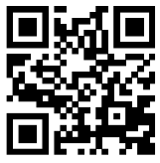
Facilitators
Erin Mercurio
Amy Lea Clemons
She/her/hers
Mercurio.40@osu.edu
She/her/hers
Clemons.32@osu.edu
Workshop Website:
Including PowerPoint slides, workshop transcript, and other resources
https://go.osu.edu/itudl
Notes:
This is for one presentation facilitator. Change the large gray text to the presentation name. Fill in the rest accordingly.

Slide 3



Outcomes
AL
Define the elements of the UDL framework
Discuss considerations for creating inclusive learning environments
Following this workshop, participants should be able to:
Apply UDL strategies to support diverse learners
Notes:
To change icon: right click on icon -> change picture -> from a file. Use existing icons from Ohio State’s Digital Asset Management system or the icon folder that comes with this template.
Up to four icons and outcomes can be listed using this template. If you add or remove outcomes and icons, ensure spacing between remains the same and all items are centered vertically on the page.

Slide 4




Participation Guidelines
EM
1
Interact!
2
Respond
3
Use Workshop Resources
Your participation matters! We’ll use anonymous Zoom polls and large group discussions to help make this content stick.
Ask questions and share ideas as we go! Use the “Raise Hand” button to speak verbally, or type in the chat.
Workshop resources, including this slide deck and plain text of the main content, are available at https://go.osu.edu/itudl
Practice Inclusion
4
Accept and respect different identities and experiences.
Listen actively and help others express their ideas fully.
Own your impact and practice empathy.
Teaching is hard, so let’s support each other.
Notes:
We need content for a generic workshop norms slide. To change icon, right click on photo -> change picture -> from a file

Slide 5
Introduction: What is UDL?
AL

Slide 6
Disability in College Students
AL
Vote for the correct answer in our Zoom poll:
Prediction: Nationally, what percentage of college students qualify for accommodations of some kind? (Or, what percentage of college students are “disabled”* according to the ADA Section 504 [2009 revision])?
What percentage of disabled college students receive accommodations?
* “Person-first” language is preferred by some people with disabilities. Recently, though, activists have recommended using “disabled person” to emphasize that disability is an identity for many. We will use both in this presentation.

Slide 7

Group Brainstorm
EM
Why might a student with a disability not have accommodations?
Use the “raise hand” button or type in the chat to help us list as many reasons as we can.

Slide 8


Beyond Accommodation: Access and Inclusion
AL
Accommodation: An adjustment to standard policy or procedure provided on a case-by-case basis. A “retrofit” of previously-existing products, services, or structures.
Accessibility (a11y): The degree to which a product, service, or system can be used by a given population. Today, this tends to refer to ways buildings, technology, and services are designed to ensure as many people as possible can interact with them as intended with as few barriers as possible.
The revised ADA (2009) defines disability broadly as any condition that “impacts/impairs one or more major life activities”
ADA Section 504 requires all post secondary institutions to provide ”accommodations” to help provide access to disabled students

Slide 9

Universal Design for Learning
EM
Originated in architecture
A collection of 3 principles that aim to add flexibility while maintaining learning goals
Based on research in neuroscience, learning sciences, and cognitive psychology
Founded on the social model of disability
Can be applied to disability and other inequalities
Source for training: CAST (Center for Applied Special Technology)
Version 3.0 more identity focused, instructor focused
Notes:
CAST: a non-profit devoted to training others in UDL and lobbying for UDL funding

Slide 10
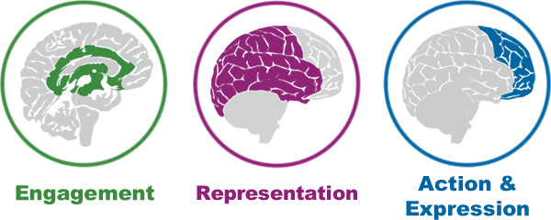
Three Principles of UDL
ALC
The Affective Dimension,
The WHY of Learning
The Recognition Network,
The WHAT of Learning
The Strategic Element,
The HOW of Learning

Slide 11
Principle 1: Multiple Means of Engagement
EM

Slide 12



Design for Engagement
EM
Welcoming Interests and Identities
“…learners differ markedly in the ways in which they can be engaged or motivated to learn.” (CAST)
Sustaining Effort and Persistence
Cultivate Emotional Capacity

Slide 13

Case study: Stats 101
EM
Three times during the semester, the instructor Mx. X has students work in new randomly selected groups to collect and analyze data.
For example, for one project, students have to analyze the number of bananas at several grocery stores in their region to estimate banana consumption in different neighborhoods. Students are given a brief prompt for each project and asked to coordinate with their group to complete it.
In end of term feedback, the students complain about the amount of group work and say they are not “learning a lot from this instructor.”

Slide 14
Case Study: Respond in the Zoom Poll
EM
Why are students in this class not engaged in group work/learning in this class?
How could Mx. X better utilize group work to engage students?
What alternative assignments, methods, or motivations could they offer to increase engagement, to meet the needs of all students?
Notes:
https://buckeyemailosu-my.sharepoint.com/:wb:/g/personal/mercurio_40_osu_edu/EbwQsUhS5apJpubkLDNGtLgBr4tkkhcduiEx0Q7TPXZuvQ?e=wmBLDQ
Keyboard users:
Space/Enter selects objects and enters edit mode once selection is made.
Escape deselects.
Arrow keys pan the canvas
Shift + up/down arrow zooms

Slide 15
Principle 2: Multiple Means of Representation
AL

Slide 16



Design for Representation
AL
Perception
“Learning, and transfer of learning, occurs when multiple representations are used, because they allow students to make connections within, as well as between, concepts.” (CAST)
Language and Symbols
Building Knowledge

Slide 17
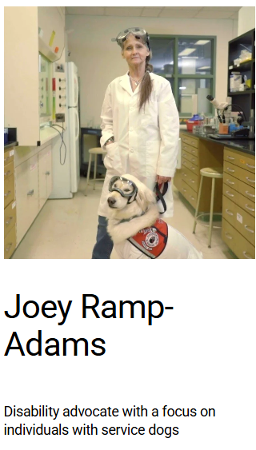

Welcoming Identities
EM
Representing many kinds of people is also important to creating a welcoming environment and improving motivation (Engagement).
When representing ideas, include representations of people from many backgrounds
iamascientist.info/collection
https://www.thedisabledcolab.com/stories
Scientist pictures
Notes:
https://www.iamascientist.info/collection

Slide 18
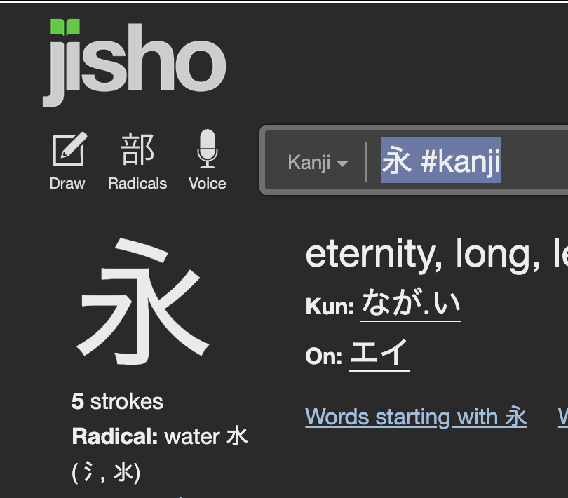
Activity: Multiple Means of Representation
AL
YouTube Shodo tutorial: https://www.youtube.com/watch?v=50KRGqOQzk4
Pull out a piece of paper and something to write with. Listen to the instructions for how to write the Japanese kanji ”ei” [eternity].
On the left, the finished character is shown to give you a starting reference.
Notes:
https://www.youtube.com/watch?v=gmGgplQkrVw

Slide 19
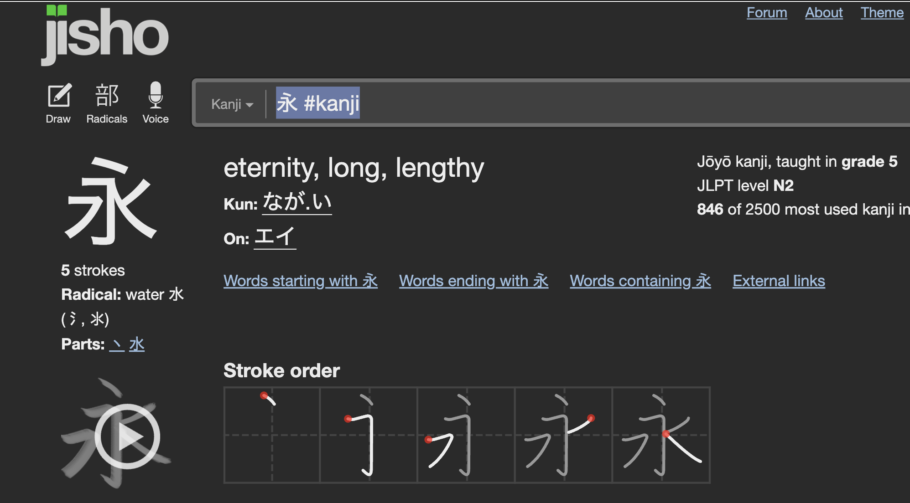
Discussion: Representing Content
AL
What made this difficult? Where did you get lost and why?
By relying on audio only, who is excluded? Who would have an advantage in this lesson?
How is this demonstration analogous to what happens in a traditional university course?
What representations has Jisho.com added to help learners understand how to write this kanji?

Slide 20
Principle 3: Multiple Means of Action and Expression
EM

Slide 21


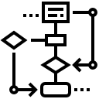
Design for Action and Expression
EM
“Learners differ in the ways that they can navigate a learning environment and express what they know.” (CAST)
Interaction
Expression and Communication
Strategy Development

Slide 22
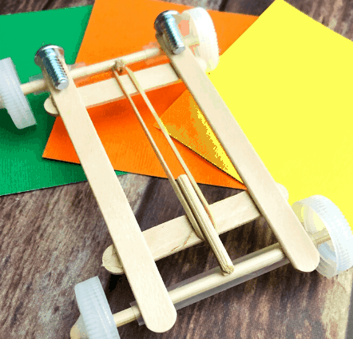
Case study: Intro to Physics
EM
A take-home exam asks students to measure elastic potential energy by building a rubber-band-powered race car.
Students must create two different designs using two different materials for the car’s body (corrugated cardboard and balsa wood), then calculate the acceleration of each car.
Who would be excluded? What inequalities does this assignment reveal?
How could this assignment be revised to be more inclusive without also stigmatizing?

Slide 23
UDL in Action
EM
Application and Implementation

Slide 24
Application
EM
For each principle, name one thing you’re already doing in the classroom or one thing you can implement tomorrow.
Notes:
https://buckeyemailosu-my.sharepoint.com/:wb:/g/personal/mercurio_40_osu_edu/EThfxFeaD61BoIvGLTSRaSgBBuOrB30vekCKBT_1DUC_Bg?e=U1OK9J

Slide 25






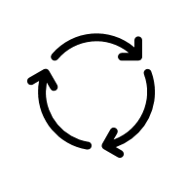


Implementing Changes to Teaching
EM
Consider Timing
Go Slow Try one new strategy at a time
When? Don't make big changes mid-semester
Don’t Give Up Refine your strategy before deciding it doesn't work
Support Students
Technologies Teach students to use new tech.
Guidance Balance flexibility with guidance and support.
Transparency Be clear about expectations and learning goals.
Use Feedback
Ongoing Feedback Check in with students to identify and adapt to their specific needs.
Midterm Feedback Use a survey or request a SGID.
Consultation Ask a consultant or colleague for support
Notes:
Generic table option, icons should be updated. To change icon, right click on photo -> change picture -> from a file

Slide 26


Resources and References
AL
Workshop Website:
Including PowerPoint slides, workshop transcript, and other UDL resources to make a more accessible classroom
https://go.osu.edu/itudl
Explore UDL Further with CAST:
https://udlguidelines.cast.org/
Reach out to the Drake for a consultation on any teaching topic at: drakeinstitute@osu.edu

Slide 27
Please provide your feedback!
We use your feedback to improve the experience for future attendees.

Slide 28
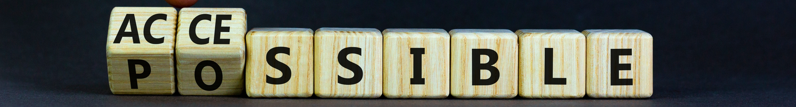
Questions and Contacts
Erin Mercurio (mercurio.40@osu.edu)
Amy Lea Clemons (clemons.32@osu.edu)

