Slide 1

Introduction to Inclusive Teaching: Universal Design for Learning
The Michael V. Drake Institute for Teaching and Learning

Slide 2


Facilitators
Erin Mercurio
Amy Lea Clemons
She/her/hers
Mercurio.40@osu.edu
She/her/hers
Clemons.32@osu.edu
Workshop Website:
Including PowerPoint slides, workshop transcript, and other resources
https://go.osu.edu/itudl

Slide 3



Outcomes
AL
Define the elements of the UDL framework
Discuss considerations for creating inclusive learning environments
Following this workshop, participants should be able to:
Apply UDL strategies to support diverse learners

Slide 4




Participation Guidelines
EM
1
Interact!
2
Respond
3
Use Workshop Resources
Your participation matters! We’ll use anonymous Zoom polls and large group discussions to help make this content stick.
Ask questions and share ideas as we go! Use the “Raise Hand” button to speak verbally, or type in the chat.
Workshop resources, including this slide deck and plain text of the main content, are available at https://go.osu.edu/itudl
Practice Inclusion
4
Accept and respect different identities and experiences.
Listen actively and help others express their ideas fully.
Own your impact and practice empathy.
Teaching is hard, so let’s support each other.

Slide 5
Introduction: What is UDL?
AL

Slide 6
Disability in College Students
AL
Vote for the correct answer in our Zoom poll:
Prediction: Nationally, what percentage of college students qualify for accommodations of some kind? (Or, what percentage of college students are “disabled”* according to the ADA Section 504 [2008 revision])?
What percentage of college students receive accommodations?
* “Person-first” language is preferred by some people with disabilities. Recently, though, activists have recommended using “disabled person” to emphasize that disability is an identity for many. We will use both in this presentation.

Slide 7

Group Brainstorm
EM
Why might a student with a disability not have accommodations?
Use the “raise hand” button or type in the chat to help us list as many reasons as we can.

Slide 8


Beyond Accommodation: Access and Inclusion
AL
Accommodation: An adjustment to standard policy or procedure provided on a case-by-case basis. A “retrofit” of previously-existing products, services, or structures.
Accessibility (a11y): The degree to which a product, service, or system can be used by a given population. Today, this tends to refer to ways buildings, technology, and services are designed to ensure as many people as possible can interact with them as intended with as few barriers as possible.
The revised ADA (2008) defines disability broadly as any condition that “impacts/impairs one or more major life activities”
ADA Section 504 requires all post secondary institutions to provide ”accommodations” to help provide access to disabled students

Slide 9

Universal Design for Learning
EM
Originated in architecture
A collection of 3 principles that aim to add flexibility while maintaining learning goals
Based on research in neuroscience, learning sciences, and cognitive psychology
Founded on the social model of disability
Can be applied to disability and other inequalities
Source for training: CAST (Center for Applied Special Technology)
Version 3.0 more identity focused, instructor focused

Slide 10
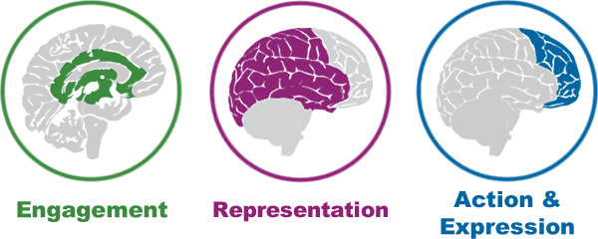
Three Principles of UDL
ALC
The Affective Dimension,
The WHY of Learning
The Recognition Network,
The WHAT of Learning
The Strategic Element,
The HOW of Learning

Slide 11
Principle 1:
Multiple Means of Engagement
EM

Slide 12



Design for Engagement
EM
Welcoming Interests and Identities
“…learners differ markedly in the ways in which they can be engaged or motivated to learn.” (CAST)
Sustaining Effort and Persistence
Cultivate Emotional Capacity

Slide 13

Case study: Stats 101
EM
Three times during the semester, the instructor Mx. X has students work in new randomly selected groups to collect and analyze data.
For example, for one project, students have to analyze the number of bananas at several grocery stores in their region to estimate banana consumption in different neighborhoods. Students are given a brief prompt for each project and asked to coordinate with their group to complete it.
In end of term feedback, the students complain about the amount of group work and say they are not “learning a lot from this instructor.”

Slide 14
Case Study: Respond in the Zoom Poll
EM
Why are students in this class not engaged in group work/learning in this class?
How could Mx. X better utilize group work to engage students?
What alternative assignments, methods, or motivations could they offer to increase engagement, to meet the needs of all students?

Slide 15
Principle 2:
Multiple Means of Representation
AL

Slide 16



Design for Representation
AL
Perception
“Learning, and transfer of learning, occurs when multiple representations are used, because they allow students to make connections within, as well as between, concepts.” (CAST)
Language and Symbols
Building Knowledge

Slide 17
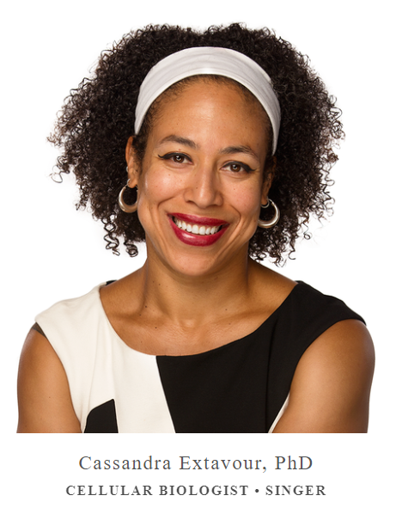

Other meanings of UDL Representation
EM
Representing multiple identities and perspectives is also important to creating a welcoming environment and improving motivation (Engagement).
When representing ideas, include representations of as many populations as possible.
Scientist pictures

Slide 18
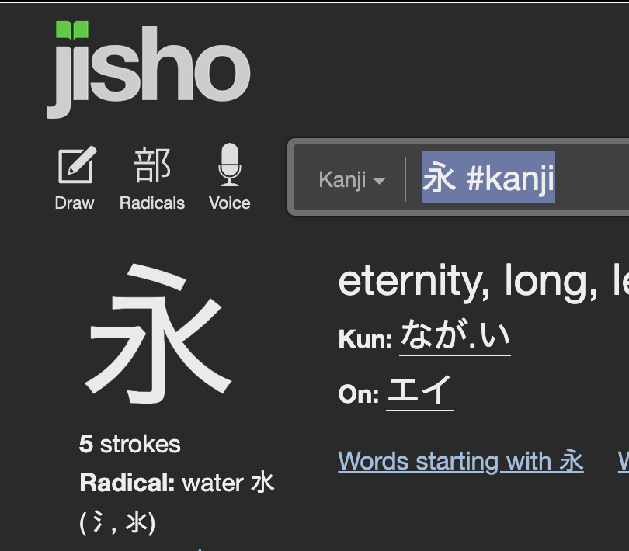
Activity: Multiple Means of Representation
AL
YouTube Shodo tutorial: https://www.youtube.com/watch?v=50KRGqOQzk4
Pull out a piece of paper and something to write with. Listen to the instructions for how to write the Japanese kanji ”ei” [eternity].
On the left, the finished character is shown to give you a starting reference.

Slide 19
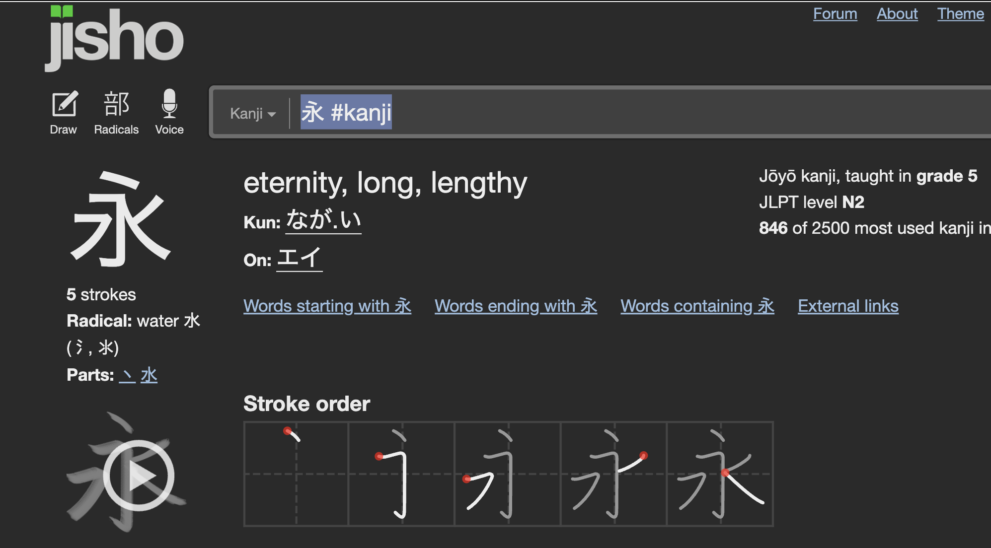
Discussion: Representing Content
AL
What made this difficult? Where did you get lost and why?
By relying on audio only, who is excluded? Who would have an advantage in this lesson?
How is this demonstration analogous to what happens in a traditional university course?
What representations has Jisho.com added to help learners understand how to write this kanji?

Slide 20
Principle 3:
Multiple Means of Action and Expression
EM

Slide 21


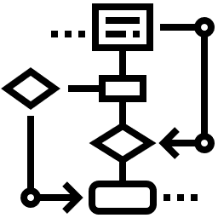
Design for
Action and Expression
EM
“Learners differ in the ways that they can navigate a learning environment and express what they know.” (CAST)
Interaction
Expression and Communication
Strategy Development

Slide 22
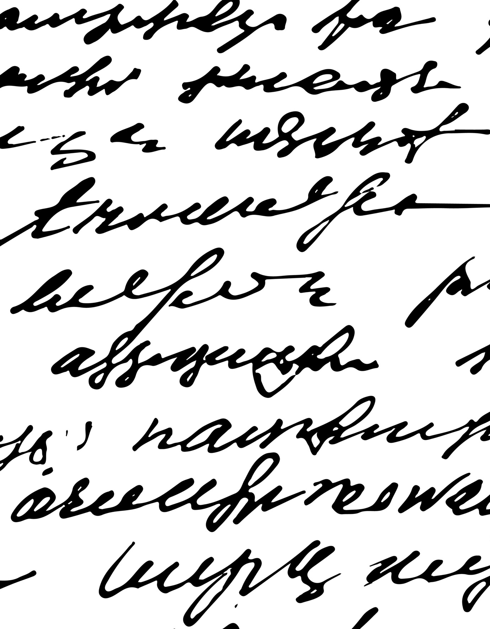
Demonstration:
Action and Expression
AL
We’re going to read you an excerpt from Paolo Freire about the banking model of education.
Using just one hand to type or using your non-dominant hand to write on paper, attempt to take “traditional” college-level notes on the material presented.

Slide 23

Discussion
AL
Imagine being able to use only one hand or having motor control issues with your dominant hand. What common tasks in a class would be difficult for you?
How can we offer flexibility or alternatives to … writing? Speaking? Other movement?

Slide 24

The Impact of “Covering Content” as Emphasis
AL
For many reasons, content-heavy classes can exclude people (students and instructors!) and interfere with the learning process.
This includes first generation students, minorities, international or ESL students.
“Covering” content ≠ Learning
More content learned ≠ Better long term outcomes

Slide 25
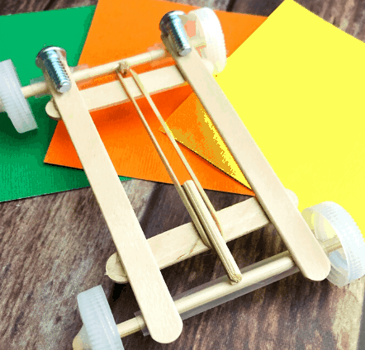
Case study:
Intro to Physics
EM
A take-home exam asks students to measure elastic potential energy by building a rubber-band-powered race car.
Students must create two different designs using two different materials for the car’s body (corrugated cardboard and balsa wood), then calculate the acceleration of each car.
Who would be excluded? What inequalities does this assignment reveal?
How could this assignment be revised to be more inclusive without also stigmatizing?

Slide 26
UDL in Action
EM
Application and Implementation

Slide 27
Application
EM
For each principle, name one thing you’re already doing in the classroom or one thing you can implement tomorrow.

Slide 28






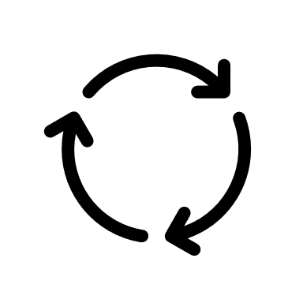


Implementing Changes to Teaching
EM
Consider Timing
Go Slow Try one new strategy at a time
When? Don't make big changes mid-semester
Don’t Give Up Refine your strategy before deciding it doesn't work
Support Students
Technologies Teach students to use new tech.
Guidance Balance flexibility with guidance and support.
Transparency Be clear about expectations and learning goals.
Use Feedback
Ongoing Feedback Check in with students to identify and adapt to their specific needs.
Midterm Feedback Use a survey or request a SGID.
Consultation Ask a consultant or colleague for support

Slide 29


Resources and References
AL
Workshop Website:
Including PowerPoint slides, workshop transcript, and other UDL resources to make a more accessible classroom
https://go.osu.edu/itudl
Explore UDL Further with CAST:
https://udlguidelines.cast.org/
Reach out to the Drake for a consultation on any teaching topic at:
drakeinstitute@osu.edu

Slide 30
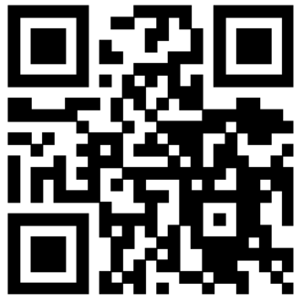
Please provide your feedback!
We use your feedback to improve the experience for future attendees.

Slide 31

Questions and Contacts
Erin Mercurio (mercurio.40@osu.edu)
Amy Lea Clemons (clemons.32@osu.edu)

