Slide 1

Title II and You: Seven Core Digital Accessibility Skills in Practice

Slide 2
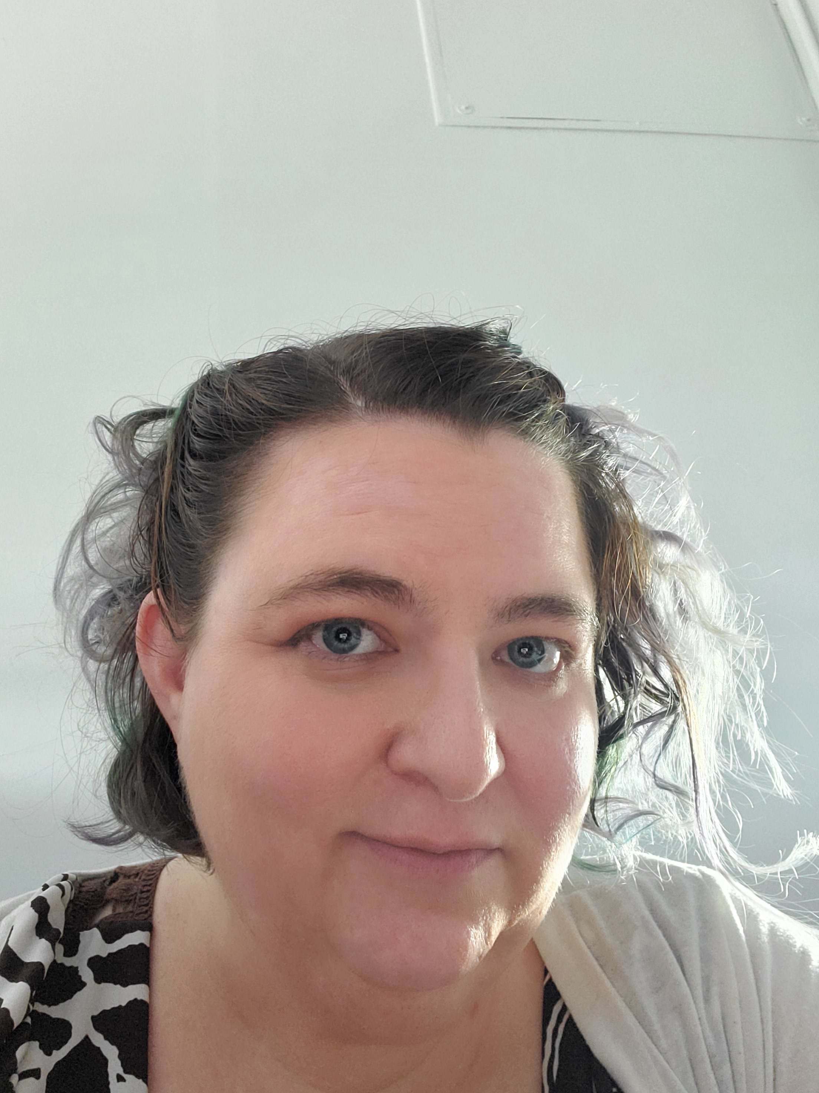
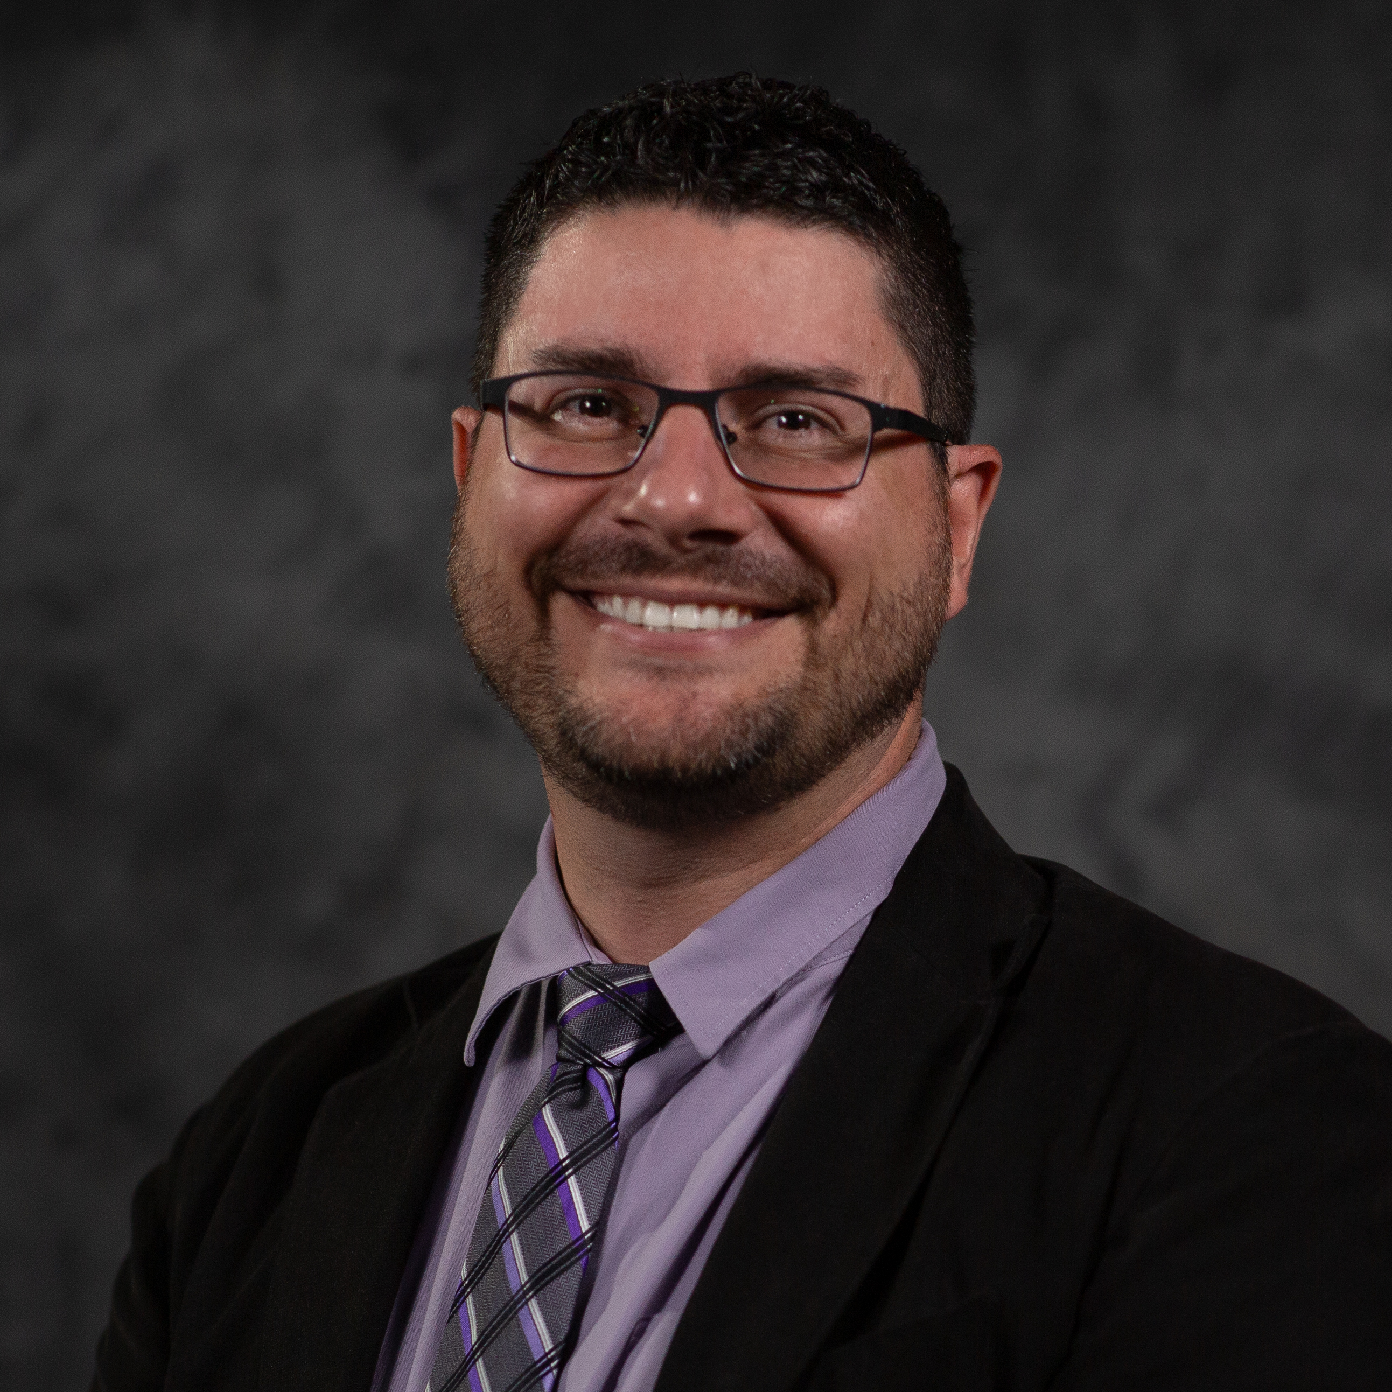
Facilitators
Amy Lea Clemons
Instructional Consultant, Drake Institute
CPACC
Web Accessibility Certified Tester
Richard Henricksen
Sr. eLearning Support Analyst, Office of Technology and Digital Innovation

Slide 3
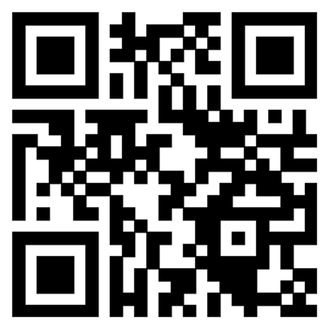
Getting Started
Please use the QR code or go to https://go.osu.edu/title27 to access the session website.
The website includes:
This PowerPoint
Sample inaccessible PowerPoint
Sample inaccessible Word document
Link to inaccessible GoogleDoc

Slide 4



Participation Guidelines
Practice With Us
Use Any Method to Participate
The goal of this workshop is to get you practicing some of the core digital accessibility skills. Be ready to work with the examples and your own
We’ll be working alone, in pairs, or in small groups—select the option that makes the most sense for you.
Support and Listen
We know some teaching topics are difficult to talk about. Be an active listener and support your colleagues when they choose to share.

Slide 5
Workshop Outcomes
name and describe the Seven Core Skills for Digital Accessibility, focusing on Headers, Lists, and Links
practice using accessible Headings, Lists, and Links to a CarmenCanvas Announcement using the Ally scanner as support
identify which Core Skills are most important for their course or discipline and will be able to assess their comfort in using these Skills

Slide 6
Seven Core Digital Accessibility Skills: An Overview

Slide 7

The Big Seven
Headings
Links
Lists
Tables
Contrast and Color
Alt-Text
Audio and Video Media

Slide 8
WCAG 2.1AA’s POUR
Digitally accessible objects, information, and activities are:
Perceivable: Headings, Color and Contrast, Alt-Text, Audio-Visual Media, Tables
Operable: Headings, Links, Lists, Tables, Audio-Visual Media
Understandable: Headings, Links, Lists, Tables
Robust: Audio and Visual Media, Headings

Slide 9
Headings

Slide 10
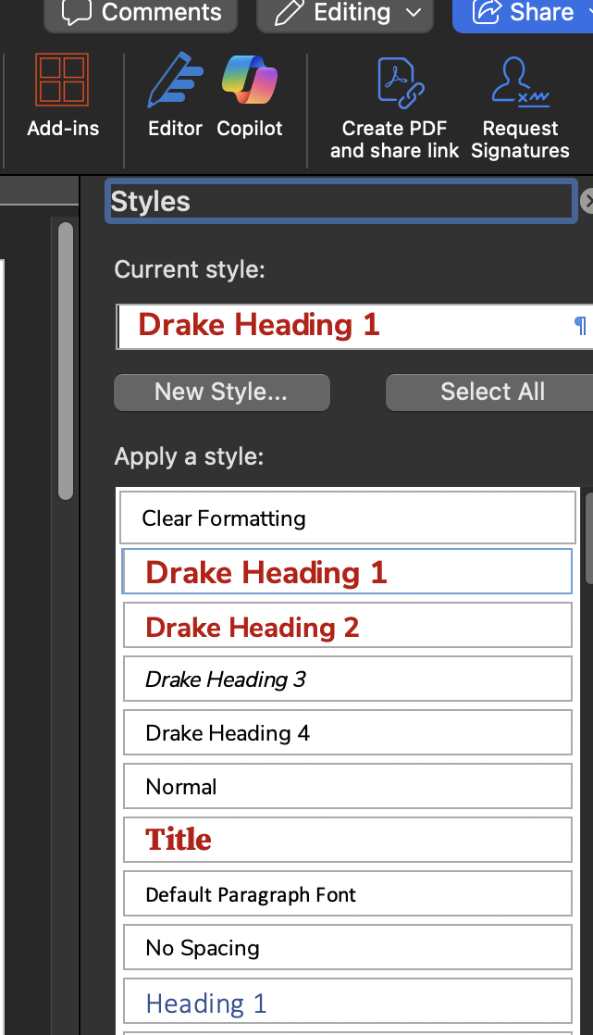
Headings: What, Why, How
Provide info about structure, information relationships, and how to navigate the document, reducing overall cognitive load for readers
Present screen reader users with a “glance” at the document and help them determine where to go. Many screen reader users navigate documents and websites primarily through the Heading structure, so adding these is a major support!
For Word: Use the Styles panel. H1 should be reserved for the document title. There is only ONE H1 per document.
For PowerPoint: All slides must have a slide title that is a) ”visible” to screen readers and b) unique.
For CarmenCanvas: Use HTML rules. H2 is the highest (biggest) level. H4 is the lowest (smallest). In the HTML for a CarmenCanvas page, you can include H5 and H6 if necessary.

Slide 11
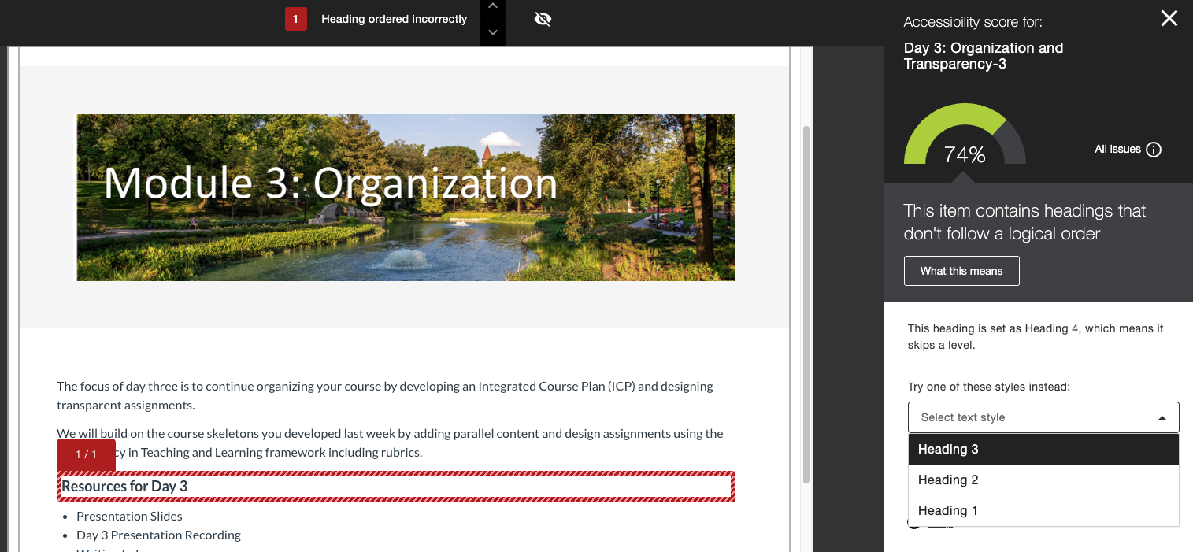
Headings in Ally

Slide 12
Practice with CarmenCanvas Announcements

Slide 13
Links

Slide 14
Links: Maintain User Expectations
Links should include meaningful text: Avoid “Click here!” Framing the link with contextual information helps all users understand what clicking the link does.
Link text should be concise. Avoid linking with entire sentences.
Don’t display the URL (unless used in academic citation). Screen readers will read the entire URL aloud if it is visually displayed on the screen.
Use Links differently from Buttons. Screen readers announce buttons as “Button: Button text” and users assume buttons are for interaction on the page (forms, quizzes, confirming information, downloading files). Links take users to other pages or other parts of a page.
Pro-Tip: Most software (including Carmen and Zoom) uses Ctrl-K (Cmd-K for Mac) to add hyperlinks.

Slide 15
Practice Links in Announcements

Slide 16
Lists

Slide 17
Lists: Use Them, But Format Them!
My To-Do List for SPRING 26 Courses
♿️ Review my course materials for potential accessibility issues, focusing on the seven core skills
♿️ Make a list of all the issues I know I can fix without much help
♿️ Make a list of all the issues I don’t know how to fix yet
♿️ Come up with a few alternatives for possibly problematic materials
♿️ Plan an extra hour per week to check on the accessibility of my courses
♿️ Learn how to use the Ally checker in CarmenCanvas
Use lists when possible instead of paragraphs, with clear labels or headers to indicate relationships
In Word and PowerPoint, make sure to use Styles to mark the list as a real list—don’t just use a dash or create your own “bullet point” graphic.
Keep lists visually consistent; don’t add extra line spaces if possible
Nested lists are fine, as long as Styles are used and there are visual markers to help sighted users understand relationships. No more than three or four levels of nesting is recommended, though

Slide 18
Practice Creating Accessible Lists

Slide 19
Accessibility Checkers

Slide 20
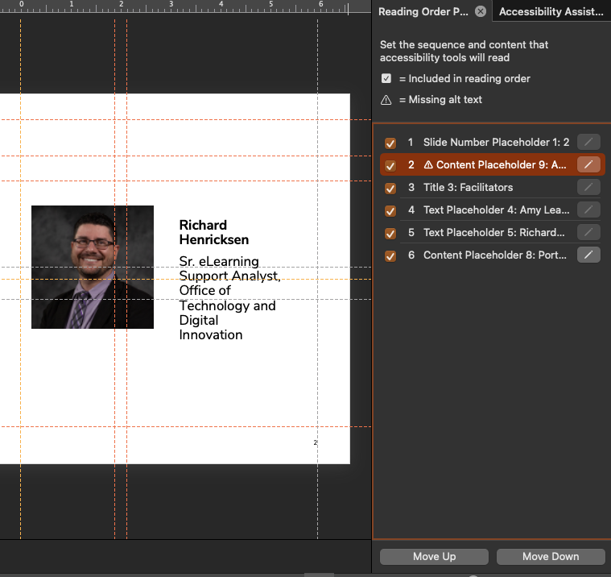
Automated Accessibility Checkers in Office Products
In Office products: Click “Accessibility: Investigate” at the bottom of a document or look under “Review” to check accessibility. MS Accessibility Checker will check for Headings, Lists, and Link issues.
Additionally, Office checks for table headers, alt-text and color contrast. Office also may automatically add AI-generated alt-text to your images, only altering you if you run the Checker.
In PowerPoint, the most important accessibility element is the Reading Order. The Reading Order tells the screen reader which item to read first, then next, then next on a given slide. Slide Title should always be the first item, and Slide Number should be the last one.

Slide 21
Practice with Sample Documents or Your Own Course Materials

Slide 22
Activity: Review Your Course
What kinds of files, pages, and other digital objects in your course are likely to have Headers, Lists, and Links?
What does Ally show you about your files and pages in CarmenCanvas?
Which digital object in the Ally list is most important to you or most important for students to understand your course? What kinds of Heading, List, and Link issues does that object have?
Now that you know about Headers, Lists, and Links, what do you need to change about how you create course materials?

Slide 23
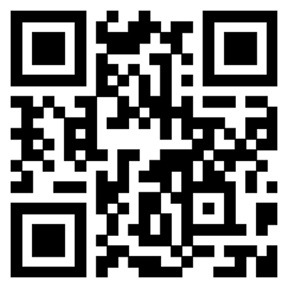
Feedback
We value your feedback.
Please take a moment to let us know about your experience today. ​
Scan the QR code or visit
https://go.osu.edu/title27-survey

Slide 24
Thank You!
Handouts, presentation files, and other resources related to this workshop are available.​ Scan the QR code or visit ​ https://go.osu.edu/title27 ​
Stay up-to-date on Drake Institute programming by visiting our events page at​ drakeinstitute.osu.edu/events​
Questions about today’s topic? E-mail Clemons.32@osu.edu or drakeinstitute@osu.edu ​

