Slide 1
Teaching the Second Year Student: What Should We Be Thinking About? Vicki Pitstick, PhD Instructional Consultant

Slide 2
Notes and Announcements
Session Time: 1:00 pm – 2:30 pm
Resources and Workshop Materials Available
https://go.osu.edu/2ndyear
Recording available upon request
Email drakeinstitute@osu.edu
Please feel free to share questions to the chat

Slide 3
Outcomess
Describe the key characteristics and needs of the second-year student
Following this workshop, participants should be able to:
Compare the cognitive & psychosocial milestones that distinguish the second-year experience
Consider teaching strategies that support second-year student learning
Notes:
To change icon: right click on icon -> change picture -> from a file. Use existing icons from Ohio State’s Digital Asset Management system or the icon folder that comes with this template.
Up to four icons and outcomes can be listed using this template. If you add or remove outcomes and icons, ensure spacing between remains the same and all items are centered vertically on the page.

Slide 4
Characterisitcs of Second-Year Students

Slide 5
Brief Discussion
How would you characterize the second-year students you teach at Ohio State?

Slide 6
Sophomore Slump Defined
An emotional experience in the second year when many students lose connections from their first year and begin to feel invisible and lost on campus.
(Schreiner, 2007a; Gansamer-Topf et al., 2007)

Slide 7
Sophomore Slump Characteristics
Novelty, mystery, & excitement of the first year dissipates
Support felt as a first-year student now directed at the NEW first-year class
Increased pressure but decreased support
Redefining sense of belonging
Residential adjustment
Broader housing options
Friendship concerns
Are they the right ones?
How can they be sustained?
General enthusiasm about college might diminish

Slide 8
Struggles with Sense of Belonging

Slide 9
What is Student Sense of Belonging?
When students feel...
valued and respected in the educational context
a sense of socio-psychological comfort and connection to the depths and quality of the group dynamics
they are being accepted for who they are without changing anything
their sense of belonging or not belonging is not just a feeling but is worn like their own skin

Slide 10
Reflection
Have you seen evidence of the sophomore slump in your students in any of your classes?
What are some examples you can think of?

Slide 11
Barriers to Second-Year Success

Slide 12
Personal and Campus Barriers
Identity confusion
No meaningful campus engagement
Campus run-around – hindering campus systems and policies
Little campus support compared to first year

Slide 13
Academic Barriers
Struggling academically
Lack of academic motivation
Major/career indecision
Lack of meaningful faculty connection
Inadequate academic advising around meaning and purpose

Slide 14
CFAES Advising Model
College Level Advisors
Handle the higher-level things
initial orientation
adding and dropping classes etc,
Faculty advisors for Each Student
looking at curriculum plans and internship/career opportunities.
Teach the classes that the students are taking earlier in their curriculum most of the time.
In FST for example, I teach the survey class and the Intro processing class, T
The other advisors are teaching other major classes.
In our department we all tell all of our students that they can come to any of us any time no matter who is their official advisor.
Peer Mentees/Mentors
In CFAES the college as well as some departments have peer mentors.
Often times the 2nd year students are both mentees and mentors.

Slide 15
Second-Year Student Development

Slide 16
Activity: Development Chart
As each type of development is introduced, fill out the following on your chart:
Circle yes or no if you have observed any of the behavior described in your students.
Write one thing you could do or change you could make to help your 2nd year students in this area.

Slide 17
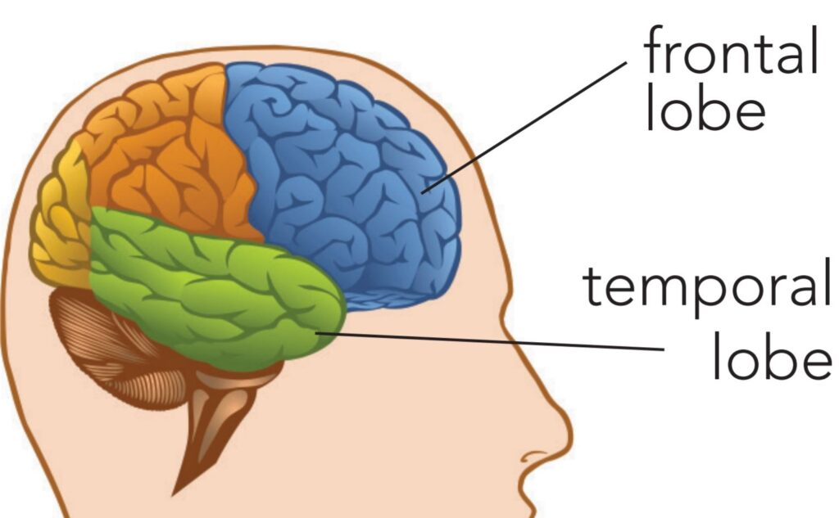
Cognitive Development Brain Development
The Prefrontal Cortex: Where we…
Maintain attention and focus
Regulate emotions
Weigh options
Make decisions
Self-evaluate

Slide 18
Cognitive Development Perry (1960’s & 70’s)
Dualism – there IS a right and a wrong answer
Received Knowledge
Basic
Full
Multiplicity - There are conflicting answers, so student must trust their own “inner voices,” not external authority
Subjective Knowledge
Early Multiplicity
Late Mulitiplicity

Slide 19
Cognitive Development Baxter-Magolda’s Ways of Knowing (1986)
Absolute
Knowledge is certain
Teacher is expert
Peers help in gaining knowledge
Task = absorbing knowledge & giving right answers
46% of 2nd year students
Transitional
Some knowledge can be questioned
Teacher facilitates understanding and application of knowledge
Peers give exposure to new views
Task = understanding then judgement
53% of 2nd year students

Slide 20
Identity Development Chickering & Reisser (1993)
Laurie Schreiner and Jerry Pattengale identified 4 vectors specific to 2nd Year Development:
Achieving Competence
Developing Autonomy
Establishing Identity
Developing Purpose

Slide 21
Schaller’s Four Stages of Sophomore Development (2005)
Random Exploration
Focused Exploration
Tentative Choices
Commitment

Slide 22
Random Exploration
Typical for 1st years but some 2nd years still here
Little to no reflection on decisions
Know they need to make major/career choice but make decisions that delay
Investigate college, explore freedom, meet new people

Slide 23
Focused Exploration
Occurs over summer or beginning of 2nd year
Questioning/Rethinking decisions about self, friends, and academic experiences made in 1st year
“Who am I?” is their main question
Need high support in this stage

Slide 24
Tentative Choices
Relates to choices that influence rest of college years
Greater sense of responsibility develops as future goals become clearer
Tentative choices made on many issues: major, career, friendships, family/dynamics

Slide 25
Commitment
Few 2nd years reach this stage
Those who do are confident in their future plans and do not doubt them
Some rush this as they just want to reach a decision and are tired of considering options

Slide 26
Discussion
Considering all the information shared about 2nd year student development, what are some changes you might consider making in your teaching approach or course for the 2nd year students you teach?

Slide 27
Second Year Student Learning

Slide 28
Developmental Readiness
Developmental Readiness: “The ability and motivation to attend to, make meaning of, and appropriate new knowledge into one’s long-term memory structures”
(Hannah & Lester, 2009)

Slide 29
Sequencing & Scaffolding
Sequencing: The order and structure in which people learn new skill sets.
Scaffolding: Support given during the learning process which is tailored to the needs of an individual student (Sawyer, 2006).
Involves practicing transparency in your teaching; explaining the why (TILT)

Slide 30
Developmental Readiness & Sequencing
Not one size fits all learning, move from assumption that time on task equates to learning (Universal Design for Learning - UDL)
Some topics might be too complex, or too simplistic where students tune out

Slide 31
Horizontal and Vertical Alignment
We know sophomores have unique needs but colleges front load and end load support (first year and seniors)
Horizontal Alignment:
Vertical Alignment:
LO
Curriculum
Assessment
Senior
Sophomore
Freshmen
Junior

Slide 32
Vertical Alignment Example
First Year
Students are new to campus
End class/an activity with structured reflection
Resources for college transition
Connecting to community
Second Year
Students have lived experience
Can begin with structured reflection
Resources for college and beyond
Connecting to self

Slide 33
Academic & Social Integration
Combining academic courses w/ co-curricular experiences...
Produces a positive student experience
Strengthens a commitment to course of study
Positively contributes to
sense of belonging
development of social skills
cross-cultural awareness
friendships
networking/social capital
(De Sisto et al., 2022)

Slide 34
Helping Second Year Students Thrive

Slide 35
Thriving
Thriving is defined as engaged learning, academic determination, social connectedness, positive perspective, and diverse citizenship (Schreiner, 2010).

Slide 36
Pathways to Thriving: Faculty Connection
Connect sophomores to faculty in intentional and meaningful ways.
Can be done through undergraduate research partnerships; faculty-student mentoring programs; faculty involvement outside the classroom.
(Schreiner, 2020)

Slide 37
The Importance of the Faculty-Student Relationship
Affects students’ views on learning (credibility, competence, and character)
Positively impacts student behavior & performance (student-centered)
Faculty can greatly impact students’ choices & decisions
It is something students desire from faculty

Slide 38
Pathways to Thriving: Community Building
2. Build community in and out of the classroom.​
Communication and interactions with students in and outside the classroom can affect performance and participation in the classroom ​
Faculty seen as more approachable (Farley-Lucas & Sargeant, 2009)​

Slide 39
Pathways to Thriving: Community
2. Build community in and out of the classroom.
Communication and interactions with students in and outside the classroom can affect performance and participation in the classroom
Faculty seen as more approachable (Farley-Lucas & Sargeant, 2009)

Slide 40
Additional Pathways to Thriving
3. Focus sophomore advising on connecting present and future identities.
This can be done through reflection activities.
4. Recognize spirituality as a pathway to thriving in sophomores.
How can you add meaningful practices to your classroom through opportunities for student expression, reflection, and critical thinking?
5. Examine institutional policies and practices from a sophomore perspective.
Be aware of campus resources to assist students with barriers they may encounter.

Slide 41
Factors of Sophomore Involvement
Institutional commitment – having a wide range of creative practices that reinforce institutional commitment for sophomores
Continued focus on the academics of the second year
They need to develop an intercultural view of diversity – structuring opportunities for students to communicate with their peers across racial and ethnic groups. (acquaintanceship; group work)
Living on campus – living on campus encourages more interaction with peers.
(Wang & Kennedy-Phillips, 2013)

Slide 42
Second Year Support Services at OSU
Career Services
Residence Life Staff (RA or Hall Director)
Counseling and Consultation Service
Embedded Counselors
Second Year Transformational Experience Program (STEP)

Slide 43
Commitment
What is one thing you can commit to doing to assist your second-year students next semester?

Slide 44
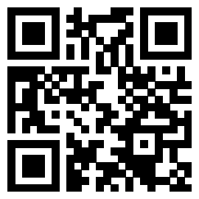
Feedback
We appreciate your feedback on our workshops! Please use the QR code or go to https://go.osu.edu/2ndyear-survey to share your input.

Slide 45
Comments or Questions
Thank you for attending!
Pitstick.10@osu.edu
drakeinstitute@osu.edu

