Slide 1

Designing Transparent Learning Experiences
Taylor June​​
(June.18@osu.edu)
Ruonan Yang
(Yang.7500@osu.edu)
Erin Mercurio
(Mercurio.40@osu.edu)
​
Notes:
Erin- 10 min
11:00 – 11:10

Slide 2

Introductions
Please pair up with someone and introduce yourself as we begin building our community.
Name
Pronouns
Department/Role
What’s something you learned during your education that you wish you learned earlier?

Slide 3
Outcomes
Identify the benefits of fostering a transparent teaching and learning environment
Apply the TILT (Transparency in Learning and Teaching) framework for assignment design
Develop strategies for addressing the “hidden curriculum”
Understand best practices for communicating course goals, expectations, and relevance to students
Following this workshop, participants should be better able to:
Notes:
Erin- 10 min
11:00 – 11:10

Slide 4

Community Norms
Listen to understand, not to respond. ​
Allow individuals the time they need to express their ideas fully. ​
Assume positive intent. ​
Own your impact on others. ​
Criticize ideas, not people. ​
Step up, step back (be aware of who has spoken and who has not.)
Utilize the oops and ouch system. ​
​
Unlocking the Hidden Curriculum: TILT It! And Beyond...

Slide 5
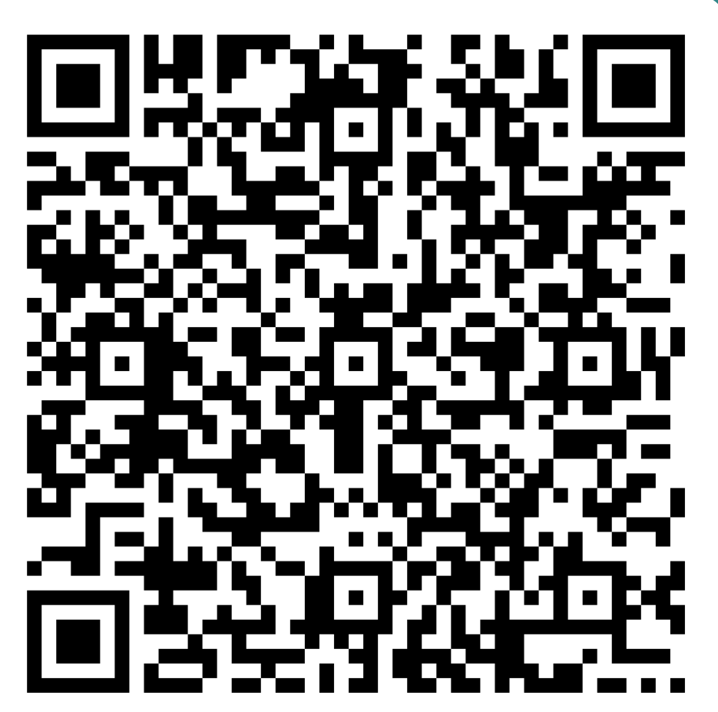
Sharing your Experience
go.osu.edu/DEJE
Think back to your first year as a college student and the challenges or obstacles you encountered
Reflection Question: What were you still learning inside and outside of the classroom?

Slide 6
Discussion Questions
What stood out to you about the responses? Why?​
How might your experience differ from that of your students? ​
Did someone teach you or otherwise support your learning? ​
If so, how? ​
If not, what guidance would you have appreciated?​

Slide 7
Transparency in Learning and Teaching (TILT)
Notes:
Shana- 30 min
11:10 – 11:40

Slide 8
Components of the TILT Framework
Purpose of Assignment
What knowledge or skills will students demonstrate?
Why are these important?
Task
What procedure will successful students follow?
Criteria
What does a good and example assignment look like? How will it be assessed? How do students know they've succeeded?
Purpose
Task
Criteria
Notes:
Shana- 30 min
11:10 – 11:40

Slide 9
Let’s Practice: Task Development
Think of a simple potential introductory task within your discipline
Prototype an assignment asking students to complete this task, including:
A short description
The first 1 to 3 steps of the assignment
Consider the following questions while creating this prototype:
Does your description identify each step of the task?
What advice could you give for each step?
What resources can you provide if a student gets stuck at a step?
Notes:
Shana- 30 min
11:10 – 11:40

Slide 10
Task Development Peer Feedback
Swap your task with a nearby partner
Read through each other’s task as if you were new to the field
Reflect and share your thoughts on the following questions:
Do you know what the task is asking you to do and/or why it is important?
What questions do you have for the instructor?
What language in the task confuses you? What language helps you?
How do you know if you have completed a step successfully?
Notes:
Shana- 30 min
11:10 – 11:40

Slide 11
Task Development Debrief
Prototype
Feedback
Reflect
Revise
How did you or your partner go about making the assignment transparent?
What was difficult about this process?
What are the benefits of designing a task with TILT in mind?
Notes:
Shana- 30 min
11:10 – 11:40

Slide 12
Writing Transparent Criteria
Weak (Not transparent)
Demonstrates critical thinking
Uses clear writing
Presents a strong argument
Transparent (Observable & Measurable)
Identifies at least two assumptions and evaluates them using course concepts
Uses discipline-specific terminology accurately
Supports claims with two relevant examples from assigned readings
Quick test for transparency:
Can students self-check before submitting? Are criteria observable? Do criteria align with the assignment’s purpose?

Slide 13
Benefits of Transparency
Notes:
August- 20 min
11:40 – 12:00

Slide 14

Why Does TILT Work?
A core element of TILT is metacognition
The structure provided TILT helps students to develop:
A plan for completing assignments as they are aware of the tasks
Criteria to monitor and adjust their progress
Moments to reflect on their learning with the explicit purpose in mind
Metacognition: Awareness and understanding of one’s cognitive processes
Notes:
August- 20 min
11:40 – 12:00

Slide 15
Benefits of TILT
After using TILT on just 2 assignments in 1 class, Winkelmes et al. (2019) reported a statistically significant increase in students’…
Academic confidence
Sense of belonging in college
Metacognitive skills
Persistence in the discipline/college
Predict: First year students who received TILT instruction persisted to their second year at a rate ____% ____ than the rest of their cohort.
Answer: 13.92% greater
Notes:
August- 20 min
11:40 – 12:00

Slide 16
Who might benefit from TILT?
TILT has also been observed to have a stronger impact on certain student groups.
Share with a partner:
What groups might benefit from transparency?
Why might transparency be helpful for these groups?
Notes:
August- 20 min
11:40 – 12:00

Slide 17
Addressing the Hidden Curriculum
Notes:
Carmi- 20 min
12:00 – 12:20

Slide 18
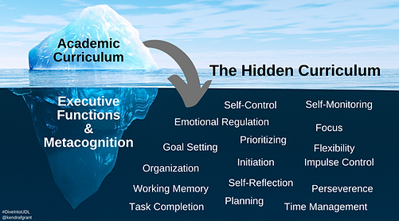
Hidden Curriculum
Implicit set of skills, knowledge, and norms that are expected of students (Jerald, 2006; Myles, 2011)
Influenced by (Cornbleth, 1984):
Instructors
Administration
Students
Society

Slide 19
Activity: The Hidden Curriculum
Think about:
What does “participation” really mean?
What does a “strong argument” look like?
How should students ask for help?
How quickly should they respond to emails?
What counts as “professional”?
How much detail is “enough”?
How should they read academic texts?
What tone is expected in writing?
On pg. 2 of your worksheet, list at least 5 hidden expectations students must understand to succeed in the space below the iceberg.
Notes:
Carmi- 20 min
12:00 – 12:20

Slide 20
Parallel Content
Sometimes, the hidden curriculum is directly relevant to course performance and becomes parallel content
If you identify parallel content in your assignments:
Gauge students’ knowledge
Explicitly teach skills/ideas
Provide external resources
Hidden Curriculum
Parallel Content

Slide 21
Example: Hidden Curriculum but not Parallel Content
Skill:
Writing professional emails
Assignment:
Write a 5-page paper explaining your idea for a research project you would like to conduct
Hidden Curriculum
Writing Professional Emails
Parallel Content

Slide 22
Example: Hidden Curriculum and Parallel Content
Skill:
Writing professional emails
Assignment:
Write a professional email to a professor that summarizes a research project you would like to conduct in their lab
Hidden Curriculum
Parallel Content
Writing Professional Emails

Slide 23
Brainstorm: Identifying Parallel & Hidden Content
Connect to iceberg
In your course
Beyond your course

Slide 24
Discussion: Teaching Parallel & Hidden Content
Share your lists of potential parallel content or hidden curriculum items
Pick one or two items on which you want to focus
Work with your group to generate potential strategies you could use to teach these skills or ideas to students

Slide 25
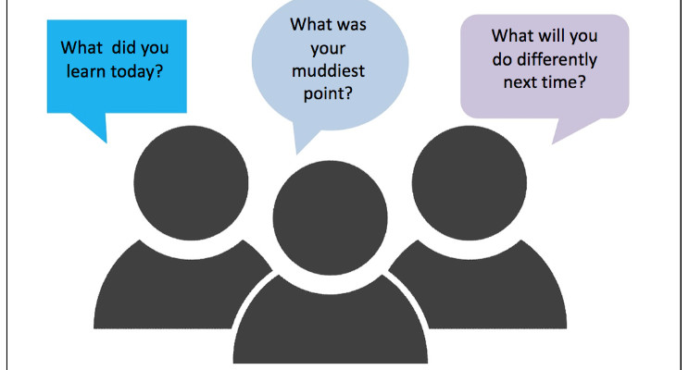
Other Strategies for Identifying Non-transparency
Classroom Assessment Techniques (Angelo & Cross, 1993)
Minute Papers
Exit Tickets
Clearest Point, Muddiest Point
Midterm Feedback on Instruction
Surveys
Small Group Instructional Diagnostics (SGID)
What did you learn today?
What was your muddiest point?
What can be done different next time?
Always find ways to learn from your students throughout a course to personalize their learning experience

Slide 26




Resources
The Drake Institute for Teaching and Learning
Drake Institute Website: https://drakeinstitute.osu.edu
Drake Institute Email: drakeinstitute@osu.edu
Classroom Assessment Techniques: A Handbook for College Teachers
Book by Thomas A. Angelo & Patricia Cross
Published: 1993 by San Francisco: Jossey-Bass
Transparent Design in Higher Education Teaching and Leadership
Edited by Mary-Ann Winkelmes, Allison Boye, & Suzanne Tapp
Published: 2019 by Stylus Publishing
See Toolkit Webpage for More Materials!
Drake Institute Graduate Toolkit Website: https://drakeinstitute.osu.edu/toolkit
Notes:
Carmi- 20 min
12:00 – 12:20

Slide 27
Thank You! Questions?
Unlocking the Hidden Curriculum: TILT It! And Beyond...
Erin Mercurio: mercurio.40@osu.edu
Taylor June: june.18@osu.edu
Ruonan Yang: yang.7500@osu.edu
Notes:
Carmi- 20 min
12:00 – 12:20

Slide 28
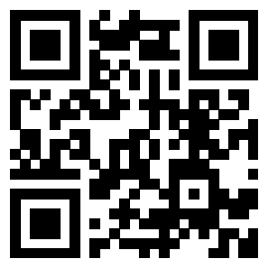
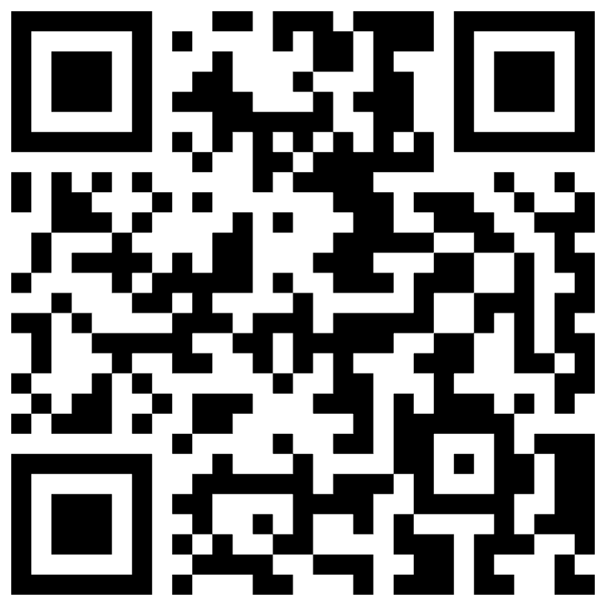
QR Code
Scan the QR below to share workshop feedback!
Scan the QR below to access Toolkit materials

