Slide 1

Creating Teaching Statements and Teaching Portfolios
Taylor June​​
(June.18@osu.edu) ​ ​​
Ruonan Yang​​
(Yang.7500@osu.edu)​
Erin Mercurio ​​
(Mercurio.40@osu.edu) ​
​
Notes:
Opening slide: Erin
To change the photo: left click text that says ”click icon to add picture,” (the icon is unclickable due to being behind content). In the Home section of the top menu bar click picture -> picture from file. If you don’t want to change the photo, delete the box by left clicking on text and pressing the backspace/delete button.
If you’d like to update the footer to the name of your presentation: In the insert section of the top menu bar click header & footer. Check the footer box, update the info to the title of the presentation, click the don’t show on title slide box and click apply to all.

Slide 2

Community Norms
Listen to understand, not to respond. ​
Allow individuals the time they need to express their ideas fully.​
Assume positive intent. ​
Own your impact on others. ​
Criticize ideas, not people.​
Step up, step back (be aware of who has spoken and who has not.)​
Utilize the oops and ouch system.

Slide 3
Learning Outcomes
Following this workshop, participants should be better able to:
Identify the purpose and value of teaching statements and portfolios
Identify the necessary elements of successful teaching statements and portfolios
Employ best practices in the writing and organization of teaching statements and portfolios

Slide 4
Agenda
Teaching Statement
Teaching Artifacts
Assessment & Evaluative Feedback
Preparing the Full Portfolio

Slide 5

Warm Up
Doodle a moment that you are proud of as an educator – tutoring, mentoring, or leading a discussion, on your worksheet.
Share with a partner and discuss how this moment could shape your teaching statements.

Slide 6
Teaching Statement
Notes:
Carmi 11-16

Slide 7
What is a Teaching Statement?
Typical length: 1–3 pages
Common use: teaching portfolios, faculty applications, and promotion/review
Main Contents:
Present Teaching Philosophy & Practice: reflect on how teaching beliefs are applied through concrete classroom strategies
Demonstrate Student Learning: show how methods engage students and promote understanding
Highlight Growth & Adaptation: illustrate how teaching evolves through reflection and new approaches
Strengthen Professional Development: describe ongoing efforts to improve teaching through training, collaboration, and self-directed learning

Slide 8
Three Main Components
1. Goal — what you want to accomplish
Engage students actively in class
Provide opportunities to practice and apply learning
2. Method — the strategies or actions you take to reach your goal
Use interactive activities and discussions
Incorporate hands-on exercises and real-world examples
3. Assessment — how you know your method worked; the evidence that shows your goal was achieved.
Observe increased student engagement in class
Track improved performance on exams and assignments
Notes:
Carmi
Shows a potential way to organize some of these ideas in the body text of your teaching statement -> these are questions that you can ponder as you begin to develop this document.

Slide 9

Haven’t Taught or Limited Experience?
Discuss what you would do
Design a class you’d like to teach in the future, including materials
Draw on other teaching experiences
Grading/Recitation
Mentorship roles
Guest lecturing
Tutoring
Department service
Notes:
August: 1-10 (~15m)

Slide 10



Activity: Show, Don’t Tell Paragraph
Step 1: Draft one “Show, Don’t Tell” paragraph for your teaching statement using the Goal → Method → Assessment structure. Step 2: Share your paragraph with your partner and provide feedback.
Step 3: Feel free to share with the workshop.
Goal
Method
Assessment
Notes:
August: 1-10 (~15m)

Slide 11

Organizing a Statement
Introduction
Overarching goal/theme
Body
Goal/Method/Assessment
Each can be its own paragraph
Typically 3-4 paragraphs
Closing
Relate back to goals and identify next steps
Tailor to the specific job
Notes:
Carmi

Slide 12
Activity: Analyzing Teaching Statement Pitfalls
Step 1: Form 4 groups and read the provided teaching statement example. Step 2: Discuss what works well and why it is effective. Step 3: Identify areas that could be improved or clarified and suggest possible revisions. Step 4: Share your group's discussions with the whole workshop.

Slide 13
Example 1:
Teaching Statement Pitfalls
Over the past five years, I have taught several courses at OSU on the following topics: survey of gender studies topics for students new to gender studies; gendered violence (both online and face-to-face); gender and pop culture, for more advanced students in gender studies; and writing about gender. I also advised incoming freshmen who entered OSU in building their semester schedules and guiding their academic paths. Before coming to OSU, I mentored instructors at my previous institution as part of a teaching and learning program. This variety of teaching experiences has informed my teaching philosophy of creating a classroom which is accessible to any student.
Notes:
Shana

Slide 14
Example 2:
Teaching Statement Pitfalls
I am an incredibly passionate instructor. I care deeply about my students and want them to feel supported in my classes. When I teach, I try to build strong relationships with students that often continue outside of class and after the course ends. I believe students respond well when they feel respected and trusted, and this helps create a positive classroom environment. I value my students as individuals and think this approach works in any teaching setting. Whether the course is online, in person, or hybrid, I aim to bring the same level of care, openness, and respect to all of my classes.
Notes:
Shana

Slide 15
Example 3:
Teaching Statement Pitfalls
I view teaching as a collaborative journey where students and I explore ideas together. My approach emphasizes active participation, encouraging students to ask questions, discuss concepts, and connect lessons to their own experiences. I often incorporate case studies, problem-solving exercises, and real-world examples to make the material meaningful and engaging. Over time, I have adjusted my teaching style based on what sparks curiosity and fosters deeper understanding, always aiming to create a supportive environment where students feel confident to explore and take intellectual risks.
Notes:
Shana

Slide 16
Example 4:
Teaching Statement Pitfalls
If you visited my classroom, you would likely see me using one or two of these techniques: short written reflections, think-pair-share, or structured group work. Since teaching online during the pandemic, I adapt these strategies by asking students to pause lecture videos for reflection or note-taking. I also make reading assignments interactive through discussion posts, offering feedback to help students develop ideas for upcoming papers. These active learning strategies keep students engaged and provide practice with complex skills like critical thinking and writing. Over time, I have expanded my repertoire of strategies and become more comfortable using them, which I believe has increased both student engagement and performance.
Notes:
Shana

Slide 17
Common Teaching Statement Pitfalls
Telling instead of showing: Use concrete examples, not just abstract claims.
Hesitant language: Avoid tentative phrasing; be confident and assertive.
Burying the lead: Make your main message clear and easy to find.
Ignoring posting requirements: Follow all guidelines and instructions carefully.
Notes:
Shana (~20m)

Slide 18
Teaching Artifacts
Notes:
Carmi: 23-26 (or whatever slides make up this section!)

Slide 19
Teaching Artifacts
Goal: Show clear, meaningful examples of your teaching in action.
Format:
Artifact - Provide the full item or a relevant excerpt.
Brief Explanation - Give context and purpose.
Description - What should your reader understand about the artifact? What do you want them to notice?
Tip: Be selective - choose artifacts that are clear and accessible to someone outside your course or discipline. Remember, your reviewer may not be familiar with your subject area.
Notes:
Carmi

Slide 20
Brainstorm:
What artifacts from your teaching might you include in your portfolio? Why?
Notes:
Carmi

Slide 21
List of Potential Teaching Artifacts
Course Syllabi
Participation Guidelines
Grading Rubrics
Handouts
Feedback Instrument
Journal Prompts
Packets
Tests/quizzes
Problem Sets
Lesson Plans
Assignments
Lecture Slides
Notes:
Carmi (~10m)

Slide 22
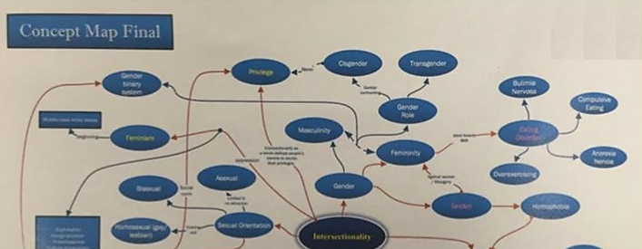
Teaching Artifact Example
Innovative Assessment: Student Concept Maps
Concept mapping, as I have assigned it across several semesters, encourages students to think both critically and creatively in order to make connections between course themes. In addition to recognizing how various hierarchies and institutions collaborate to produce privilege and oppression, students learn to situate their own identities in relation to these social and cultural mechanisms. Below are two examples."
Gender, Culture, and Society (Summer 2016, Section 4801)
Students were asked to map course concepts of their choice, but had to include feminism, heteronormativity, intersectionality, and hierarchies."
Notes:
Shana 24-32

Slide 23
Activity: Artifact Interview
Instructions:
Pair up with a partner.
Take turns sharing one artifact from your course (current or former).
The listener interviews the presenter about their choice.
Focus on:
What is most exciting or interesting about this artifact to you?
Why did you choose this particular artifact?
What do you hope the reviewer understands or notices from it?
How does this artifact represent your teaching values or approach?
Notes:
Carmi

Slide 24
Assessment & Evaluative Feedback
Notes:
Shana (Assessment & Evaluative Feedback)

Slide 25
Group Brainstorm:
What are some ways to show a teaching practice is working?
Notes:
All?

Slide 26
Formal v. Informal Feedback
Evaluative Feedback
Formal
Informal
SEIs
Evaluations not from students
SGIDs
Peer evaluations
Advisor/mentor or other faculty
Classroom Assessment Techniques (CATs)
Instructor- or department-generated survey
Student comments from your feedback forms
Student correspondence
Observations of student behavior/engagement
Changes in student work quality
Notes:
Shana

Slide 27
Using Quantitative and Qualitative Evidence
Evaluative Feedback
Quantitative
Qualitative
What do the numbers show?
Note improvements
Provide explanations behind significant shifts or trends
Tell a story about the numbers with narrative explanation
Selective, but representative​
Organize into categories that identify broader trends
Split up or excerpt longer comments​
Identify comments which have led to changes in course design/instruction
Notes:
Shana

Slide 28
Example Quantitative Assessment Evidence - Graph of SEI Scores
Notes:
Carmi (~10m)

Slide 29
Example Qualitative Assessment Evidence – Student Quotes
“I always felt heard in the class and [that] he created an environment where I felt comfortable. I really looked forward to this class each week.”​
“… by the end of the semester I was able to look at my classmates as actual friends… What is also amazing is that even someone as big and bold as myself is terrified of giving presentations, but I felt to be on such a level of friendship with my classmates that all that anxiety went away.”
Notes:
Carmi (~10m)

Slide 30
Brainstorm:
What evaluative feedback do you currently have and what might you seek out in the future?
Notes:
Shana (~13m)
Think-Pair-Share as flex activity if time (+~5m)

Slide 31
Preparing the Full Portfolio
Notes:
August 34-39 (~7m)

Slide 32

Portfolio Components
Goal:
Teaching statement
Teaching responsibility
Method:
Teaching artifact(s)
Assessment:
Evaluative feedback- SEIs and other forms of quantitative and qualitative feedback
Observation reports
Notes:
Materials list. To change icon, right click on photo -> change picture -> from a file
August

Slide 33




Tips for Writing
Show, Don’t Tell
Don’t merely talk about how what you do is effective in the classroom, provide your audience with assessment evidence
Avoid Deficit-based or Criticizing Statements
Keep it positive and refer to your own classroom experiences and what you’ve witnessed in practice
Avoid Declarative Statements
Such as “That’s how students learn”
Consider Your Audience
Tailor your portfolio to the job and consider language, discipline-specific terminology, and formatting requirements
Notes:
August

Slide 34
Getting Ahead on Your Portfolio
Document feedback:
Save students’ comments, feedback, and correspondence and request feedback
Reflect:
Brainstorm and/or revise your goals as an instructor and what practices you employ to achieve those goals
Curate artifacts:
Find teaching materials you feel were successful, taking notes of your why and your intent behind the assignment
Request teaching observations:
Identify faculty or consultants who can observe your teaching and provide written feedback
How to prepare to assemble a teaching portfolio
Notes:
August

Slide 35




On Campus Resources
The Drake Institute for Teaching and Learning
Drake Institute Website: https://drakeinstitute.osu.edu
Drake Institute Email: drakeinstitute@osu.edu
Buckeye Careers
Career Services Website: https://careers.osu.edu
Career Services Email: careerquestions@osu.edu
The Writing Center
Writing Center Website: https://cstw.osu.edu
Writing Center Email: cstw@osu.edu
The Graduate School (GATA)
Graduate School Website: https://gradsch.osu.edu/
GATA Email:
grad-schoolfellowships@osu.edu
Notes:
August

Slide 36
Creating Teaching Statements and Teaching Portfolios
Erin Mercurio: mercurio.40@osu.edu
Taylor June: june.18@osu.edu
Ruonan Yang: yang.7500@osu.edu
Notes:
August

Slide 37
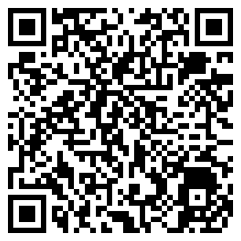
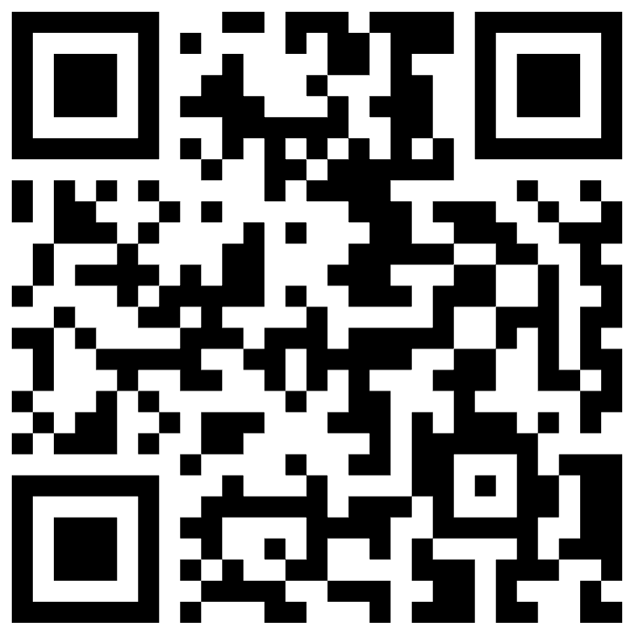
Scan the QR below to share workshop feedback!
Scan the QR below to access Toolkit materials

