Slide 1

Seven Skills for Digital Accessibility
A pilot presentation

Slide 2
Digital Accessibility
Mandated by ADA Title II Final Rule
Legally follows WCAG 2.1 AA, even for non—web digital products
Includes Canvas pages and content posted to Canvas

Slide 3
Skill 1: Headings
Tips:
Match visual style to heading meaning (Bigger = more abstract; smaller = more specific)
In Word, use “Styles” to label your Headers “semantically”
In PowerPoint, use View/Outline to see major headings and other landmarks
In Canvas, use the WYSIWYG editor to select “H2” as your top level header (Canvas automatically creates an H1 for the page title), or use the HTML editor to manually add and style the Headings.
Provides info about structure, information relationships, and how to navigate
Screen readers depend on a good heading structure to present users with a “glance” at the document and help them determine where to go
Those with cognitive disabilities use heading systems to provide information about information priority
Follows HTML rules: Consider H1 for document titles, H2 for major subsection titles, H3 for sub-sub sections, and down to H6.

Slide 4
Skill 2: Links
Links should include meaningful text: ” Write as you normally would, then highlight the text you want to make into a link, and insert the link.” Avoid “Click here!”
Link text should be concise. Avoid linking with entire sentences.
Don’t display the URL (unless used in academic citation).
Some Canvas templates offer links that look like buttons. Make sure that the link purpose is clear: is this taking users to an external site? Internal page? Or will this initiate a file download?

Slide 5
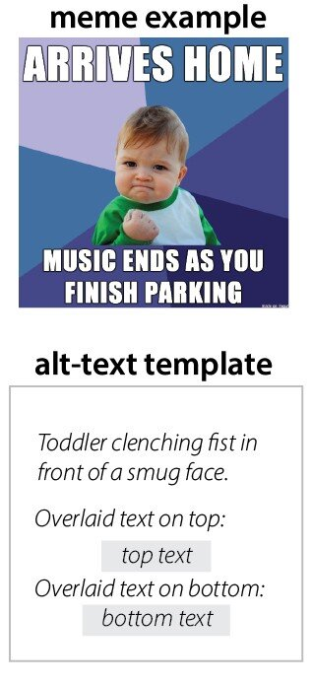
Skill 3: Alt Text
Alt text is used for “meaningful images”
Alt text is not used for “decorative” images
The alt text decision tree can help! See: https://www.w3.org/WAI/tutorials/images/decision-tree/
Long alt text (more than 125 characters) should be used for complex charts, graphs, and scientific diagrams. Placement of this depends on the document type—html (including Canvas), Word, PPTX, Excel and PDF call for different placements of long alt text.
Review advice from U Minn’s 7 Core Skills—Accessibility page for graph, chart, and data analysis situations

Slide 6
Skill 4: Lists
Who does this particular skill benefit?
Why is this considered a UDL principle?
See https://autisticadvocacy.org/resources/accessibility/easyread/ for more writing style advice
--Use lists when possible instead of paragraphs, with clear labels or headers to indicate relationships
--In Word and PowerPoint, make sure to use Styles to mark the list as a real list—don’t just use a dash or create your own “bullet point” graphic. (For non-Canvas Web, there is a way to do this in CSS if you really need it).
--Keep lists visually consistent; don’t add extra line spaces if possible
--Nested lists are fine, as long as Styles are used and there are visual markers to help sighted users understand relationships.

Slide 7
Skill 5: Tables
Rule | Reason
Use tables to display ONLY data | Tables used to provide visual design can be confusing for screen reader users and there are better ways to help users understand information (like lists and headers)
Use tables primarily to show relationships among data | Tables work best when comparing and contrasting data across cells. Data that aren’t being compared can be displayed in easier to read ways
Avoid “complex” tables with merged cells, split cells, and internal headers | Screen readers struggle with explaining these kinds of tables and they are difficult to navigate with a keyboard.
Do not use empty cells (except A1) if possible; use N/A or other indicators | Screen readers will not say “empty cell” and users can’t tell if the cell is truly empty or if their tech is glitching
Designate row and/or column headers | Screen readers struggle to understand the relationships presented in the table without designated headers to label columns or rows
Provide a caption for the table in Word and PDF | Captions aren’t the same as headers or titles. To add a caption in Word, look under “Table Properties”

Slide 8
Skill 6: Contrast and Color
Foreground
WCAG 2.1 AA: Foreground text should be at least 4.5:1 ratio to background color (assuming 14 point or higher font size). For large text, 3:1 is acceptable.
Select
For patterned backgrounds select multiple areas to test
Use
Use the WebAIM contrast checker and CollorZilla (https://webaim.org/resources/contrastchecker/) or install WCAG contrast checker Chrome extension
Check
Check your color choices for colorblindness issues.

Slide 9
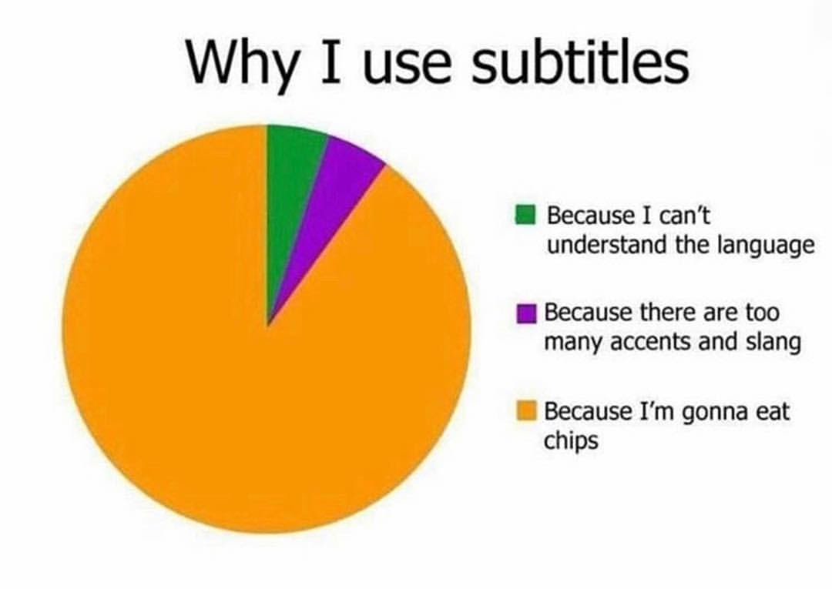
Skill 7: Video and Audio media
Prerecorded (not live) media must be accessible.
In-player captions are required. These must be “cleaned” and not auto-generated. MS Stream, supported by CoPilot, does a pretty good job at cleaning Zoom files.
Provide a transcript that can be downloaded. MS Stream can reduce time with this task. This is necessary for audio-only files.
Audio descriptions are required, either as part of the audio track (or normal speech) or as an additional track and file.

Slide 10
PowerPoint-Specific Skills

Slide 11
PPT Accessibility Checker
What it checks
Color and contrast
  Identifies likely errors in both contrast and color
  Sometimes offers alternative color options
Media and Illustrations
  Identifies missing alt text
  Identifies missing audio and video subtitles (fully embedded media only)
Tables
  Identifies missing headers
  Recommends header placements
  Identifies merged and split cells (complex tables)
Document Structure
  Identifies missing slide titles
  Duplicate slide titles
  Reading order
  Section name use
  Duplicate section names
Document Access
What it doesn’t check
Font size
Understandability of content
Aesthetics/Branding alignment
Understandability of structure to sighted users
Accuracy of alt text and captions
Presence of audio description for video files
Visual consistency of headings and slide style
Link use
Length of alt text/need for long alt text

Slide 12
Document Structure
Mac Users
Under Review/Accessibility, select ”Selection Pane.”
Screen readers will read the items listed in reverse order (bottom to top).
There is no way to uncheck decorative objects here, so make sure to do it on the slide.
Reading Order
PC Users
Under Review/Accessibility, select the Reading Order Pane
Screen readers will read each object aloud in the order you see (1-n). Make sure it’s reading these in the correct order.
Adjust the order by click and dragging items in the Reading Order pane. For decorative objects, uncheck the box to tell the screen reader to ignore that item if it isn’t already unchecked.
If objects disappear, you may need to do some creative grouping. See the MS PPT Reading Order help page for more tips.

Slide 13

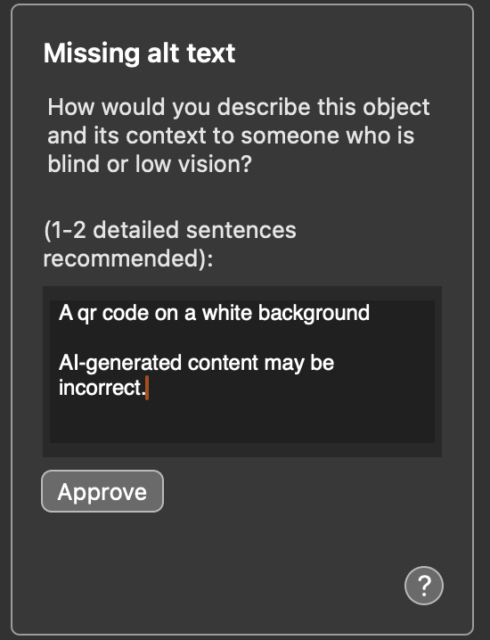
Auto-generated Alt-text
For many image files, PowerPoint will attempt to provide alt text for you. You will need to review these to ensure they are
Accurate
Meeting your goals/fulfilling the intended purpose
Providing adequate and appropriate context for those with low or no vision

