Slide 1

Syllabus Strategies to Foster Student Sense of Belonging

Slide 2

Facilitators
Audrey Harlyn, MA
Program Manager
Drake Institute for
Teaching and Learning
Harlyn.1@osu.edu
Vicki Pitstick, PhD
Instructional Consultant
Drake Institute for
Teaching and Learning
Pitstick.10@osu.edu
Rachel Tuttle, EdD
Senior Lecturer
Department of
Educational Studies
Tuttle.146@osu.edu
Drake Institute Affiliates
for donating Syllabus examples!

Slide 3
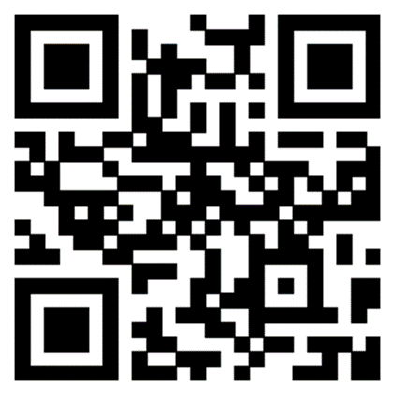
Workshop Guidelines
Participation
Interactive Elements
Access to Materials
Participants may have cameras on or off.
If you have a question, please use the “raise your hand” feature or post in the chat.
  Interactive Chat
  Poll response – scanned QR codes or links
  Syllabus review – downloaded files
https://go.osu.edu/syllabus-strategies

Slide 4
Today’s Learning Outcomes
Participants will be able to:
Define how academic belonging fits into a student’s overall sense of belonging.
Describe intentional design strategies that can utilize the syllabus as a tool to contribute to student sense of belonging.
Implement syllabus design choices that demonstrate and align with participant’s personalized approach to fostering student sense of belonging.
Identify ways to demonstrate support for students’ mental health and well-being.

Slide 5

Session Outline
Student Sense of Belonging
Syllabus Strategies
  Part 1: Set Expectations for an Inclusive Classroom
  Part 2: Consider Context
    Dennis Learning Center
Questions & Final Thoughts
Wrap-Up

Slide 6
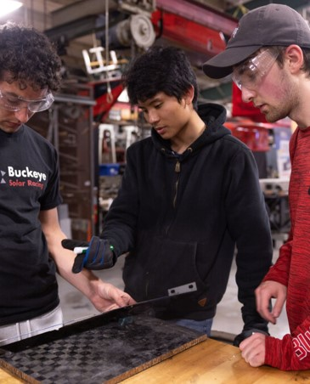
What is Student Sense of Belonging?
When students feel...
valued and respected in the educational context
a sense of socio-psychological comfort and connection to the depths and quality of the group dynamics
they are being accepted for who they are without changing anything
their sense of belonging or not belonging is not just a feeling but is worn like their own skin

Slide 7
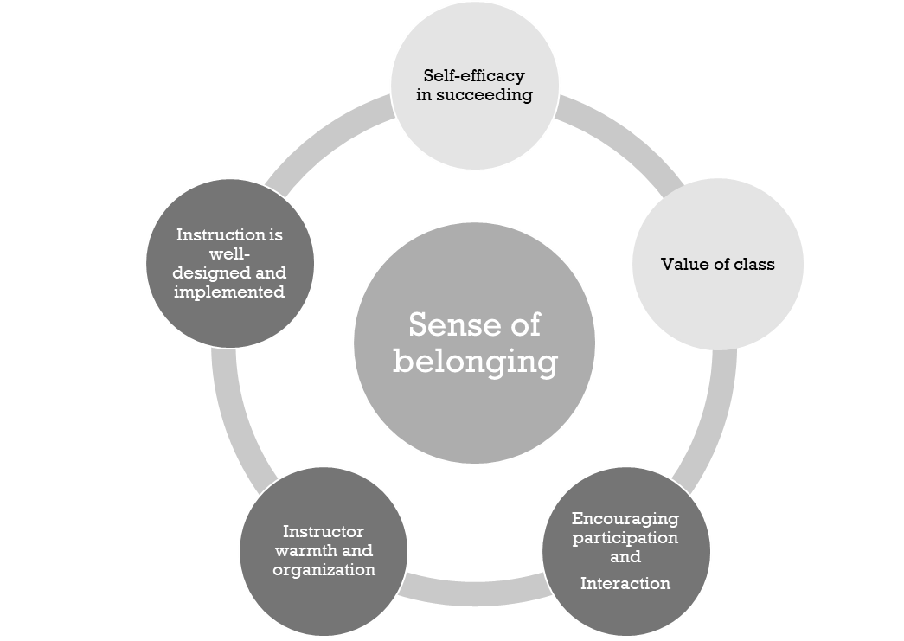
Academic Belonging
When a student feels competent and comfortable in class.
(Nunn, 2021)

Slide 8
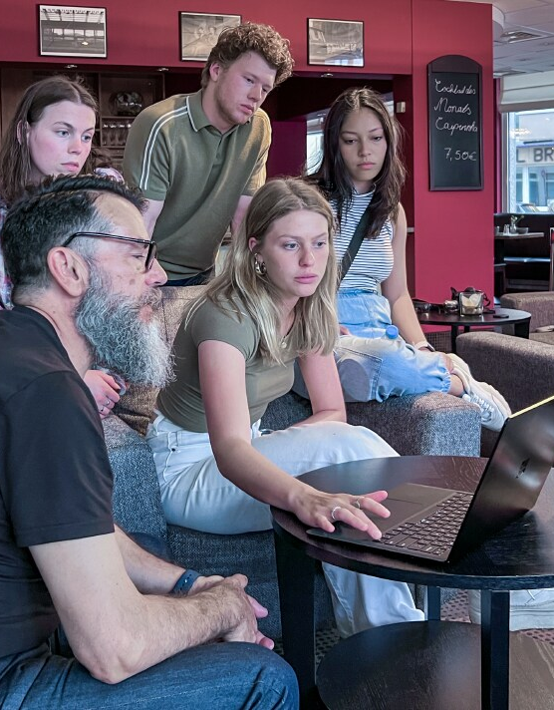
Why it matters
Higher level of student motivation to learn that leads to higher achievement
More participation and engagement from students
The words of a faculty member make an impact on students
One staff or faculty member who cares in a student's life can not only affect success in their chosen field but can positively impact their overall well-being.

Slide 9
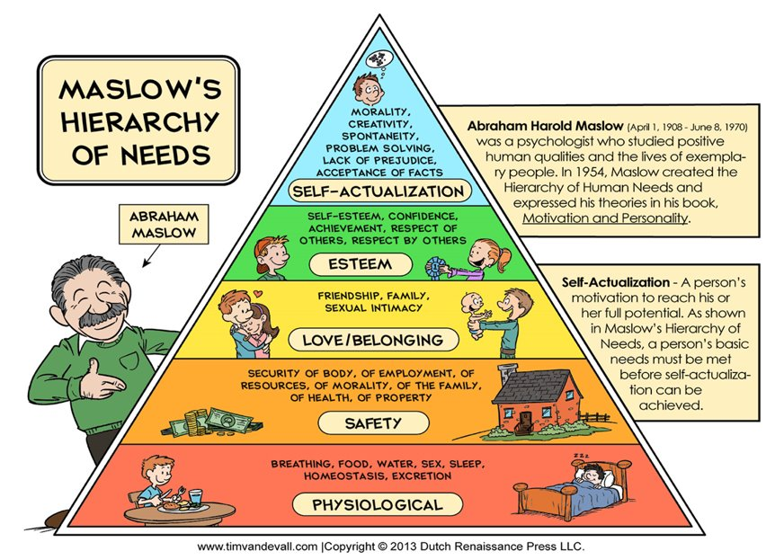

Slide 10

Growth Mindset + Growth Culture
"Mindset culture is so powerful that it can actually block an individual's growth mindset."
(Murphy, 2024)

Slide 11

Growth Mindset Culture
An environment that communicates through its policies, processes, and norms the belief that intelligence and ability can be grown over time through hard work, the use of effective strategies, and asking for help when needed.
A Growth Mindset Classroom Culture...
Improves student engagement & learning
Increases student sense of belonging
Increase levels of trust between instructor and students

Slide 12
A Growth Mindset-Focused Syllabus
Demonstrates instructor believes in students' ability to grow
Normalizes course material can be challenging
Communicates instructor cares about students' success
Communicates instructor wants students to feel a sense of belonging in their classroom
Provides resources that help students w/ academic and non-academic challenges

Slide 13

Conversation:
Answer in the chat or out loud
Why might faculty hesitate to build deeper connections with students or focus on sense of belonging?

Slide 14

The Syllabus

Slide 15
Part 1:
Set Expectations for an Inclusive Classroom

Slide 16


Slide 18
The Syllabus as a Contract
Part 1: Set Expectations for an Inclusive Classroom
Drawbacks of just presenting the syllabus as a Contract
Extend the metaphor - use the syllabus as a Living Constitution
Makes the syllabus a defensive tool
Creates an adversarial relationship that can inhibit belonging in the classroom
Can reinforce power disparities between instructors and students
Further challenge the creation of a community of belonging
Designed to construct a thriving community
Outlines membership in the community and what we can expect from and owe to ourselves and our fellow community members
Symbolic tool to communicate the goals and ethos of the community
Invites participation; allows for evolution (or amendment)

Slide 19
The Syllabus as a
Living Constitution
Part 1: Set Expectations for an Inclusive Classroom
What the Instructor can expect from Students
What Students can expect from the Instructor
What Students can expect from each other

Slide 20
The Syllabus as a
Living Constitution
Part 1: Set Expectations for an Inclusive Classroom
What the Instructor can expect from Students
What could you add?
What parts of the syllabus could you develop with your students?
What Students can expect from the Instructor
What Students can expect from each other

Slide 21
The Syllabus as a
Living Constitution
Part 1: Set Expectations for an Inclusive Classroom
What the Instructor can expect from Students
Consider adding:
How students can appeal their grade
Information about how and when instructors will turn around graded assignments
How students can secure accommodations to which they are entitled
Demystify office hours; make them more flexible
What Students can expect from the Instructor
What Students can expect from each other

Slide 22
The Syllabus as a
Living Constitution
Part 1: Set Expectations for an Inclusive Classroom
What the Instructor can expect from Students
What could you add?
How could you gather this input?
What Students can expect from the Instructor
What Students can expect from each other

Slide 23
The Syllabus as a
Living Constitution
Part 1: Set Expectations for an Inclusive Classroom
What the Instructor can expect from Students
Consider adding:
Statement that multiple perspectives are not only welcome, but critical to the learning experience
Statement of how violation of standards set for inclusive participation will be handled
Description of why use of technology can be distracting to other students
What Students can expect from the Instructor
What Students can expect from each other

Slide 24
Syllabus Review Activity
What the Instructor can expect from Students
Take a few minutes to review the syllabus:
How can the syllabus be strengthened to better define:
  What students can expect from the instructor
  What students can expect from each other
Plan to report back
What Students can expect from the Instructor
What Students can expect from each other
AH

Slide 25
Debrief
What the Instructor can expect from Students
How can the syllabus be strengthened to better define:
  What students can expect from the instructor
  What students can expect from each other
What Students can expect from the Instructor
What Students can expect from each other
AH

Slide 26
Communicate Your Commitment to
Inclusive Teaching
Part 1: Set Expectations for an Inclusive Classroom
Draft Meaningful Messages:
Personalize standardized Accessibility Statements
  Notes of encouragement to follow up with instructor
  Information on how to access or arrange resources for the specific class
Include a Success Statement
  Counteract any assumptions students might have about the course/discipline or the instructor’s sentiments (e.g., “this is a ‘weed out’ class”)
  Use the syllabus to directly tell students that they belong, and you believe they can succeed in your course

Slide 27
The academic misconduct policy describes an ethical obligation that you have in this course. Our disability policy describes one that I have to you! I am committed to helping all students achieve our learning goals, and making all learning experiences in this course accessible to all students. I recognize that doing this fairly doesn’t mean treating everyone in the same way! I have a chronic pain condition myself that means I sometimes need extensions on my own work. I might even request some flexibility from you over the course of the semester for this reason. In turn, you should feel free to keep me informed about what I can do to help make course materials, activities, and assignments more accessible or useful to you, even if your disability is not (or not yet) registered with Disability Services.
As I mention in the previous policies, I am usually open to giving extensions on assignments and additional support to students for any reason, regardless of whether they disclose a disability. However, if you do anticipate reasons that you will need regular or specific accommodations (for reasons related to your mental health, chronic, or temporary medical conditions), I encourage you to register with Student Life Disability Services so that you can get appropriate, consistent, and fair accommodations applied to all your classes.

Slide 28
1
Your completion of the prerequisite coursework is evidence that you all have the capability of succeeding in this course with some guidance through potential bottlenecks and we encourage you to reach out to your peers, TAs, and instructors when you experience these bottlenecks. Successful scientific investigation requires the collaboration of diverse perspectives to overcome these obstacles.
2
Your contributions in this course are important and valued. You bring your unique background, personality, opinions, and knowledge. I encourage you to share with others to the extent you feel comfortable and ask that you listen to your peers, so you not only learn about them, but you also grow as a teacher, and as a human being. You belong here. Your interest in the topic and desire to learn are seen. In this class we will use various methods to learn about college biology teaching. These are both to support you as diverse learners, and to showcase methods you can use in your own courses to support your students. We will discuss topics in pairs, small groups, and as a whole class. You will give presentations on topics of your choosing and methods you align with your own learning outcomes you set. You will reflect each week on our readings in a way that is meaningful to you. I’ve included in our curriculum the voices of diverse writers and researchers.

Slide 29

Communicate Your Commitment to Inclusive Teaching
Part 1: Set Expectations for an Inclusive Classroom
Use of images and quotations:
Consider what they suggest about who is included or what message they convey

Slide 30
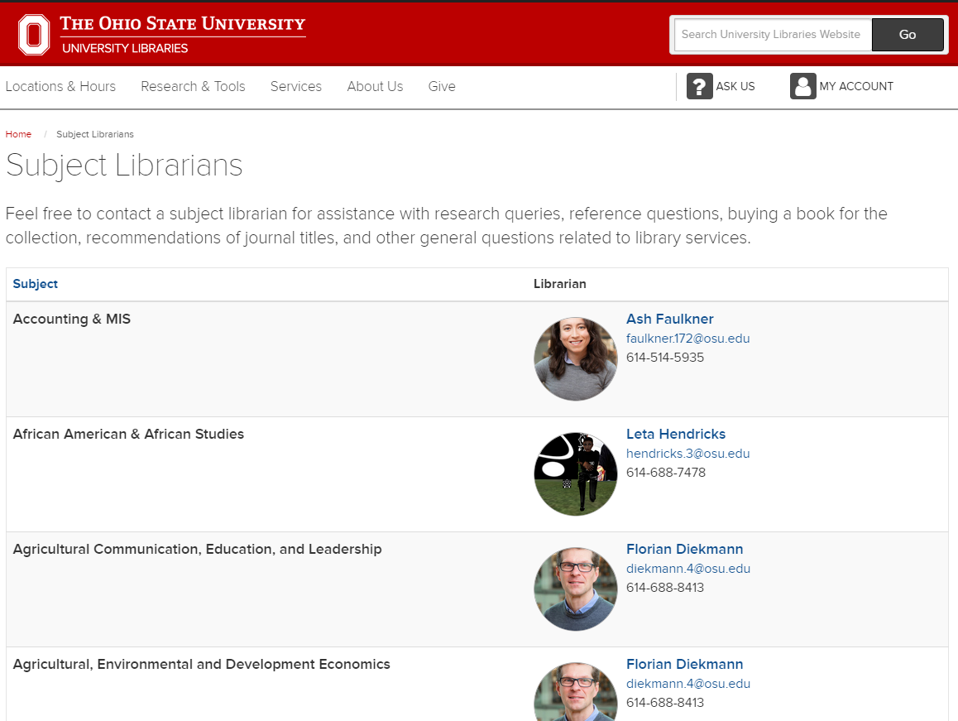
Communicate Your Commitment to Inclusive Teaching
Part 1: Set Expectations for an Inclusive Classroom
List your trainings or certifications that demonstrate your learning about different groups or populations of students
  Debate to Dialogue
  Facilitating Intergroup Dialogue
  Implicit Bias training
  REACH training
  Teaching Endorsements
  Workshops
Incorporate diverse perspectives into your course materials
  Utilize the University Libraries’ Subject Librarians

Slide 31

Tone
Part 1: Set Expectations for an Inclusive Classroom
Avoid third-person (“students shall”) and instead use first-person (“I”, “we”, “you”)
Use a conversational or collaborative tone; positive or friendly language; humor
Use self-disclosure; share personal experiences
Show enthusiasm for teaching & subject matter

Slide 32
Present the Material in a Tone that Conveys Respect
Part 1: Set Expectations for an Inclusive Classroom
LARGE CAPITAL LETTERS CAN MAKE A STUDENT FEEL LIKE THEY ARE BEING REPRIMANDED, SOMETIMES BEFORE THE INSTRUCTOR AND STUDENT HAVE EVEN MET!!!
AVOID USING ALL-CAPS WORDS FOR EMPHASIS!!!
THIS IS SEEN AS HOW ONE YELLS AT SOMEONE IN TEXTING OR ONLINE!!!

Slide 33
Part 2:
Consider Context

Slide 34
Rachel Tuttle, EdD
Senior Lecturer
Dennis Learning Center | Department of Educational Studies

Slide 35
Dennis Learning Center
Support and encourage active learning and self-regulated learning strategies​ (in our classes and through our syllabus)
SRL is cyclical and reiterative (it reoccurs)
Phase 1
Plan
Phase 2
Monitor
Phase 4
Evaluate
Phase 3
Control

Slide 36
Dennis Learning Center
PRIOR to the start of the semester, plan out (and include in your syllabus):
Assignment due dates and instructions and details (if possible, recommended time estimates and/or lengths of assignments)
  Clearly state late policy
  Identify ways to scaffold assignments
  Plan around academic calendar and personal calendar
Feedback expectations (type of feedback and when they can expect grading to be completed)
Communication expectations (from you and from the students)
Participation and engagement expectations
  Consider flexibility for illness, life situations

Slide 37
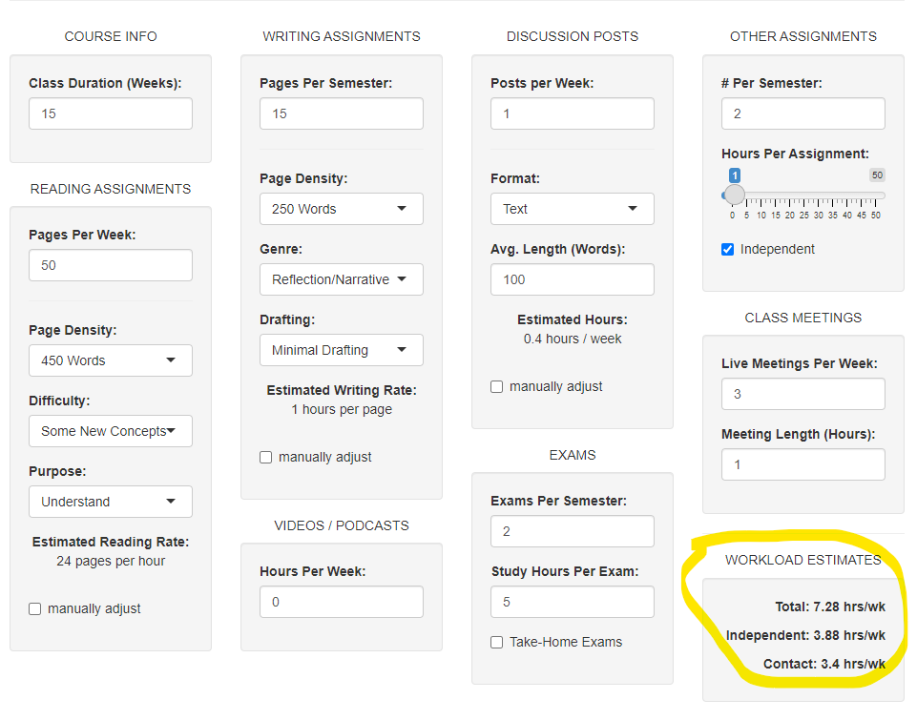
Tool: Workload Calculator
Part 2: Consider Context

Slide 38
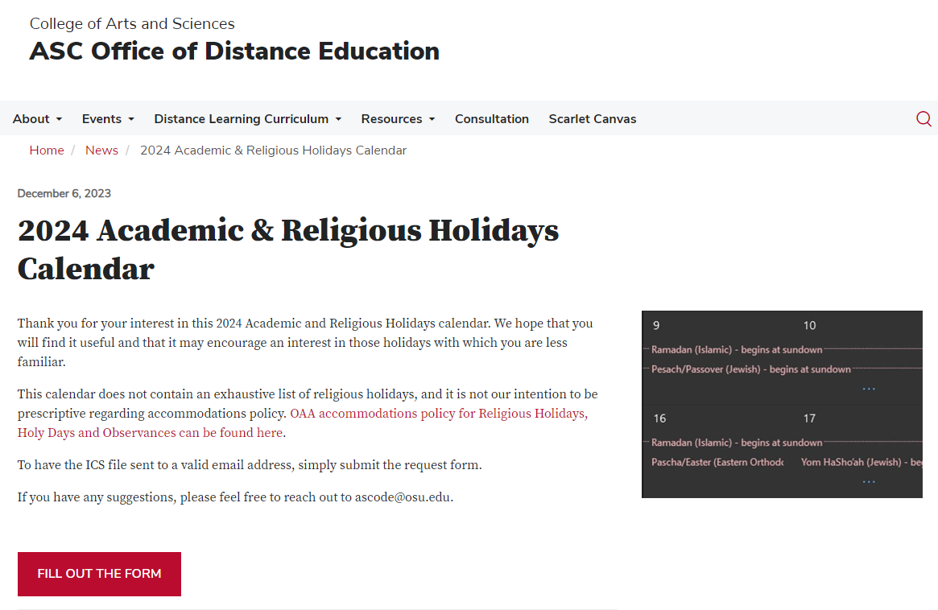
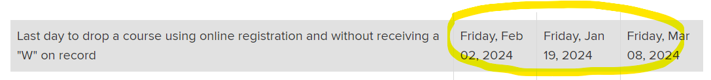
Tool: Calendar
Part 2: Consider Context

Slide 39
Student Centered Course Policies
Part 2: Consider Context
Course Policies: Intent
Course Policies: Impact
Set clear expectations and boundaries for appropriate conduct
Hold all students accountable for appropriately challenging standards
Send message to students that they are not valued or that the instructor assumes that they will act unethically and irresponsibly
Can disproportionately negatively effect students who are minoritized and/or underserved
Can lead to lower sense of belonging and greater identity threat

Slide 40
Conduct a Student-Centered Policy Review
Part 2: Consider Context
Review your course policies through the student lens
Key ingredients for Student-Centered Policies:
All students can comply with policies without an undue burden being placed on any student group
Communicate respect and care for students as engaged and capable members of the learning community
Take into account the diversity and complexity of students' lived experiences by viewing students as individuals whose lives extend beyond the classroom and considering how their different roles can influence their experiences in your class.

Slide 41
Remove, Revise, Replace Policies
Part 2: Consider Context
Example 1:
Example 2:
Lowest Homework Grade Drop Policy:
There is a homework assignment due every week. At the end of the term, your lowest two homework grades will be dropped, and will not be included in your overall course grade.
Late Work Grace Period:
Once in the term, if needed, you may turn in an assignment up to 2 days (48 hours) late for full marks. In order to receive full marks on your assignment, you must notify the TA at least 24 hours prior to the original due date that you will be using your late-work-grace period. You do not need to provide a reason for using your grace period.

Slide 42
Group Exercise – Revise This Policy
The following student identity groups are represented in your course:
Commuter students
First generation college students
Students from groups underrepresented in higher education or specific fields
Students learning English as an additional language
Students with disabilities
Undocumented students
Key ingredients for Student-Centered Policies:
All students can comply with policies without an undue burden being placed on any student group
Communicate respect and care for students as engaged and capable members of the learning community
Take into account the diversity and complexity of students' lived experiences by viewing students as individuals whose lives extend beyond the classroom and considering how their different roles can influence their experiences in your class.
Assignments are due at the end of class on the date stated in your course schedule. I will not accept any assignments that are handed in past the due date. I will only extend due dates personally if you have a documented excuse. If you have an issue of this nature that you need to discuss with me, please email me or come by during my office hours. I will not address these issues before, during, or after class time. There is also the possibility that I will extend due dates for the whole class if I feel it is necessary to do so.

Slide 43
“Part 3” What’s Next?
Parallel Content
Scaffolding
Transparency
Rubrics
Skills, abilities, foundational content pieces
Often crucial components of disciplinary work
Can be overlooked as course content
Intentional design of students’ learning experience providing concrete incremental steps from which they can build knowledge
Build in opportunities for formative assessment
Transparent assignments communicate the task, its purpose, and the criteria for task evaluation before students begin work
Grading guide that makes explicit the criteria for evaluating students’ work
Inform students of expectations while they are learning

Slide 44
Learn More
Upcoming Workshops:
3/24: Classroom Environment Strategies to Foster Student Sense of Belonging and Build Achievement
4/10: Introduction to Inclusive Teaching: Universal Design for Learning
4/17: Working with Neurodivergent Students
4/30: From Debate to Dialogue: Conversation Strategies to Build Connection across Difference
TLRC Articles:
Creating an Inclusive Environment in CarmenZoom
Inclusive Teaching: Understanding and Supporting Diversity
Online and Hybrid Syllabus Template Instructions
Preparing to Teach at Ohio State
Shaping a Positive Learning Environment
Supporting Student Learning and Metacognition
Universal Design for Learning: Planning with All Students in Mind

Slide 45
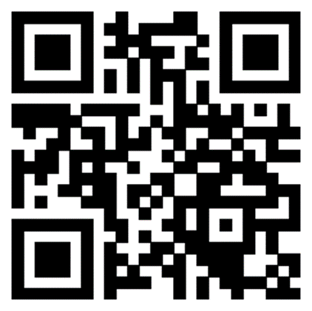
Discussion
Final Questions
We value your feedback!
Please take a moment to let us know about your experience today.
Scan the QR code or visit:
https://go.osu.edu/syllabus-survey
Audrey Harlyn, MA
Harlyn.1@osu.edu
Vicki Pitstick, PhD
Pitstick.10@osu.edu
Rachel Tuttle, EdD
Tuttle.146@osu.edu

