Slide 1
Crafting Teaching Statements and Teaching Portfolios
Welcome! We’d love to know who’s here. Please share your name, role, and the reason you are attending this workshop in the chat.
AA

Slide 2
Welcome!
Workshop Facilitators
Anika Anthony, PhD
Pronouns: She/her
Associate Vice Provost & Director
Erin Mercurio, PhD
Pronouns: She/her
Assistant Director for Graduate Initiatives
2
AA

Slide 3
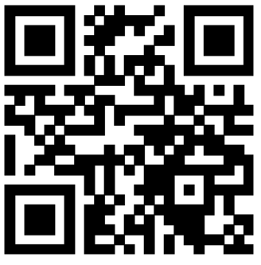
Workshop Materials
Handouts, presentation files, and other resources related to this workshop are available.​
Scan the QR code or visit ​
https://go.osu.edu/teaching-statements
AA

Slide 4




Learning Outcomes
Describe the format and components of teaching portfolios and teaching statements
Structure a teaching statement around goals, methods, and assessment
Following this workshop, participants should be able to:
Identify general strategies for effectively documenting teaching
Reflect on the story they want to tell about their teaching
AA

Slide 5
Guidelines for Today’s Session
Use video as you feel comfortable
Participate in activities by writing in the chat or speaking (please use the “raise hand” button)
Ask questions at any time
AA

Slide 6
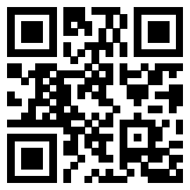
Please let us know you're here!
Scan the QR code provided to virtually "sign in" to this session. Your information will be automatically recorded upon scanning.
You can also visit
https://go.osu.edu/fpms23
AA

Slide 7
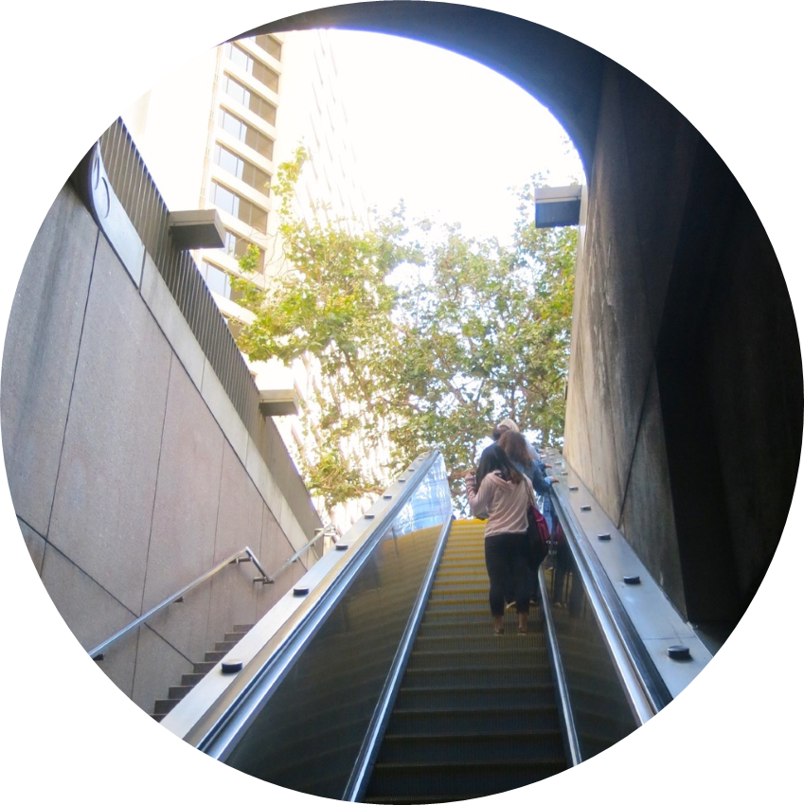
The Teaching Statement
Also called a philosophy of teaching, teaching interest statement
Practices may differ between fields
Many purposes – job market, awards, annual review, promotion and tenure
Evolves with you and your teaching
Reflective document with concrete examples
Usually 1-2 pages, present tense, first person
EM

Slide 8
Teaching Statement Tips
Consider your audience (Terminology, Focus)
“Own” your statement by turning to your experiences and observations
Avoid deficit-based or criticizing statements
Be careful of declarative statements: “Lecturing is an outdated and inefficient way of teaching” vs. “When I lecture, I incorporate short activities, which allow students to…”
EM

Slide 9
Teaching Statement Pitfalls
What feedback or advice would you give to the author of this statement?
EM

Slide 10
Example 1
From the first time I entered a classroom, I have always been drawn to teaching. Since then, I have had the opportunity to teach a variety of courses at OSU: a survey of gender studies topics for students new to gender studies; gendered violence (both online and face-to-face); and a gender and pop culture course for advanced students in gender studies. I am also passionate about advising and mentoring. Before coming to OSU, I mentored instructors at my previous institution as part of a teaching and learning program. I truly care about my students and their learning. I think that students like the way that I treat them with trust and genuine interest. I believe that my approach of valuing students is applicable in any context, including online, face to face teaching, and hybrid courses.
EM

Slide 11
Three Main Components
Goal
Method
Assessment
EM

Slide 12
Three Main Components, Continued
What do you want to accomplish?
How do you make it happen?
How do you know it works?
EM

Slide 13
Three Main Components: Examples
“I want my students to be engaged in class and have opportunities to practice what they are learning.”
“I involve my students in many activities and discussions. For example…”
“As a result, students are more engaged and do better on their exams than before I began this practice.”
EM (AA)

Slide 14
Reflecting on Your Teaching
Considering your teaching responsibilities, please list 1 – 3 teaching goals.
1.
2.
3.
AA

Slide 15



Method: “Show, don’t tell”
EM

Slide 16
Reflecting on Your Teaching Cont.
Select one of your teaching goals, and list at least one method.
Methods | Assessments | Use of Assessment Information to Improve Teaching
AA

Slide 17
Assessment: Group Brainstorm
What are some ways to show a teaching practice is working?
AA

Slide 18
Assessment Evidence
Assessment Evidence can be formal or informal
The standard of evidence required is different than in research
Consider using quotations from students to bring the student voice into your statement
AA

Slide 19
Formative Assessment Cycle
Reflect
Set Goals
Plan
Teach
Assess
AA

Slide 20
Reflecting on Assessment
Considering your teaching methods, what are your assessments? How do you know they work?
Methods | Assessments | Use of Assessment Information to Improve Teaching
AA

Slide 21

Organizing a Statement
Introduction
  Overarching theme or connection
Body
  3-4 Goal/Method/Assessment
  Each can be its own paragraph
Closing
  Relate back to goals or future directions
EM

Slide 22
For Faculty Seeking Promotion & Tenure: Ohio State's Core Dossier
Approach to and Goals in Teaching Narrative
Approach to and goals in teaching and student mentoring
Major accomplishments during the time period under review
Future plans for teaching and student mentoring
Evaluation of Teaching Narrative
Describe how you have used evaluation information (SEIs, peer evaluations of teaching, other feedback) to improve the quality of your teaching and student mentoring
AA

Slide 23
For Faculty Seeking Promotion & Tenure: Ohio State's Core Dossier Cont.
Curriculum Development
Specific examples of involvement in curriculum development, development of new teaching methods or materials, or creation of new programs
Professional Development Related to Teaching
Continuing education programs related to teaching you have completed since date of hire at Ohio State or last promotion, whichever is sooner (e.g., Drake Institute programs and services; Other teaching development programs)
AA

Slide 24
Teaching Statement Pitfalls Exercise
What feedback or advice would you give to the author of this statement?
EM

Slide 25
Example 2
If you were to visit my classroom on any given day, you would probably see me use one or two of the following teaching techniques: i) short written reflections on lecture content, ii) think-pair-share, and iii) structured group work. More recently, I have been teaching online due to the pandemic. Incorporating these teaching techniques in the online context is more difficult, but to make students’ online experience more like it would be in person, I often ask students to pause the lecture video to reflect or answer questions in their notes at key moments during the lecture. Whether my course is in person or online, I also attempt to make reading assignments more interactive by using discussion posts to guide students’ reading of the text and to help them brainstorm relevant ideas and arguments in advance of class discussions. Although the posts are not graded, I do provide some feedback on them, mostly offering suggestions about how they might continue to develop their ideas for an upcoming paper. These active learning strategies keep students engaged and offer students the practice and feedback they need to learn complex skills like critical thinking and writing. Over time, I have developed a greater range of active learning strategies and greater comfort using them in the classroom, and I believe students in my courses are more engaged and perform better precisely because of this change in my teaching.
EM

Slide 26
Common Teaching Statement Pitfalls
Telling instead of showing
Hesitant language
Burying the lede
Overreliance on one type of assessment
Not acknowledging shifts in teaching
Ignoring requirements
EM/AA

Slide 27
Examples of Requirements
Job posting
Graduate Associate Teaching Award guidelines
Appointment, Promotion, and Tenure documents
Core Dossier Outline and Instructions document
AA

Slide 28
Portfolio Components
Goal:
Teaching statement
Diversity statement
Method:
Teaching artifacts
Assessment:
SEIs or other forms of feedback
Quantitative and qualitative feedback
Observation reports
EM

Slide 29

Getting ahead on your portfolio
Document
  Save correspondence and all copies of teaching artifacts
Reflect
Ask for feedback from peers, students, and consultants
EM

Slide 30

Other than Syllabi, what artifacts from your teaching could you put in your portfolio?
EM

Slide 31
Teaching Artifacts
course syllabi
course handouts
course packets
course lesson plans
class participation guidelines
midterm feedback instrument
tests/quizzes
assignments
grading rubrics
journal prompts
problem sets
reading lists/reading prompts
slides
What does your reader need to see?
EM

Slide 32
Evidence of Teaching Effectiveness
Formal
Informal
SEIs
Evaluations not from students
  SGIDs (UCAT)
  Peer evaluations
  Advisor/mentor, etc.
Classroom Assessment Techniques (CATs)
Instructor-generated discursive evaluations
Student comments from your feedback forms
Student correspondence
Observations of student behavior/engagement
Changes in student work quality
EM

Slide 33
Evidence of Teaching Effectiveness, continued
Quantitative
Qualitative
Tell your story by providing narrative explanation.
What do the numbers show?
  Improvements
  Explanations behind significant shifts or trends
Selective but representative
Sort into categories to help your reader see trends
Split up or excerpt longer comments
Which comments have led to changes?
EM

Slide 34
Writing about Evidence of Effectiveness
At Ohio State, you may have the opportunity to write an extended statement about evidence of effectiveness
Consider:
  What are some ways you collect student feedback, or otherwise assess your teaching?
  What themes have emerged from this feedback? Do any align with your teaching statement?
  Can you give examples of times you’ve used feedback to make a change in your teaching?
  How might your teaching move forward from here?
EM

Slide 35

Help your Readers! 1
Present a cohesive narrative
Organize and order based on guidelines (e.g., call for apps or promotions and tenure guidelines)
Consider visual presentation and formatting
Provide explanations: for context or to guide the reader (example)
EM

Slide 36
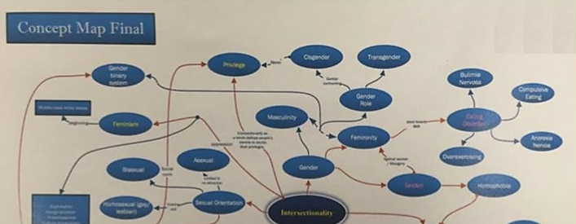
Teaching Artifact Example
Innovative Assessment: Student Concept Maps
Concept mapping, as I have assigned it across several semesters, encourages students to think both critically and creatively to make connections between course themes. In addition to recognizing how various hierarchies and institutions collaborate to produce privilege and oppression, students learn to situate their own identities in relation to these social and cultural mechanisms. Below are two examples.
Gender, Culture, and Society (Summer 2016, Section 4801)
Students were asked to map course concepts of their choice, but had to include feminism, heteronormativity, intersectionality, and hierarchies.
EM

Slide 37

Limited Teaching Experience?
Discuss what you will/would do
Make artifacts for a future course
Utilize any teaching experience
  Grading/Recitation Leader
  Mentorship and Tutoring
  Guest lecturing
  Department Service (assignment or curriculum development)
EM

Slide 38




Resources
The Drake Institute provides consultations on teaching statements and portfolios
Feedback from others in your field is also essential!
Other teaching centers with good online resources: Waterloo and the University of Michigan
Find examples and resources at the workshop website: https://go.osu.edu/teaching-statements
AA

Slide 39
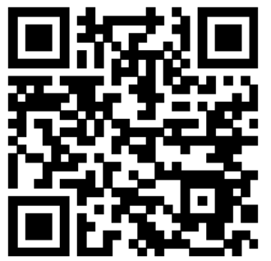
Thank You!
Feedback Survey
go.osu.edu/teaching-statements-survey
Stay up-to-date on Drake Institute programming by visiting our events page at​
https://drakeinstitute.osu.edu/workshops-and-events
Questions about today’s topic?
E-mail drakeinstitute@osu.edu ​
EM

