Slide 1

Beginning Steps of Course Design
Taylor June​​
(June.18@osu.edu)
Ruonan Yang
(Yang.7500@osu.edu)
Erin Mercurio
(Mercurio.40@osu.edu)
​
Notes:
Carmi 1-22

Slide 2

Community Norms
Listen to understand, not to respond. ​
Allow individuals the time they need to express their ideas fully. ​
Assume positive intent. ​
Own your impact on others. ​
Criticize ideas, not people. ​
Step up, step back (be aware of who has spoken and who has not.) ​
Utilize the oops and ouch system. ​
​

Slide 3
Learning Objectives
Following this workshop, participants should be better able to:
Describe the steps of the backward design process and its rationale.
Identify how backward design can improve clarity, alignment, and effectiveness in teaching and learning.
Practice designing course goals, learning outcomes, and assessment plans using backward design principles.
Develop a preliminary framework and gather resources for future course design or teaching projects.

Slide 4
Course Design Approaches

Slide 5

Think-Pair-Share: Approaches to Course Design
Share with a partner on the following questions:
What would your Dream Course look like if you could teach it?
What are some strategies you might use to start designing this course?
Notes:
Time: maybe 3 minutes?

Slide 6
Content Approach to Design
Start
Teaching Strategies
Content
Assignments
Learning Outcomes
Course Goals
End
Notes:
Can start with geology textbook example + explanation for why this is a popular approach ; the new approach to course design ; talk about why these strategies tend to fall in this order (can use example from own teaching to illustrate this)
New lecturer at XYZ university – have to teach an intro to earth history course...from SCRATCH. A popular way to take on this kind of course design is through a content based approach, where you start with some form of content (like a textbook or collection of textbooks) and figure everything out from there. More teacher centered

Slide 7
Backwards Approach to Design
End
Teaching Strategies
Content
Assignments
Learning Outcomes
Course Goals
Start
Notes:
Given an example to this, by the end of this course, students will learn how earth scientists apply field and laboratory skills to better understand the functioning of earth systems. Students should be able to: identify basic minerals and rocks, collect geological samples, etc
More student focused in development

Slide 8
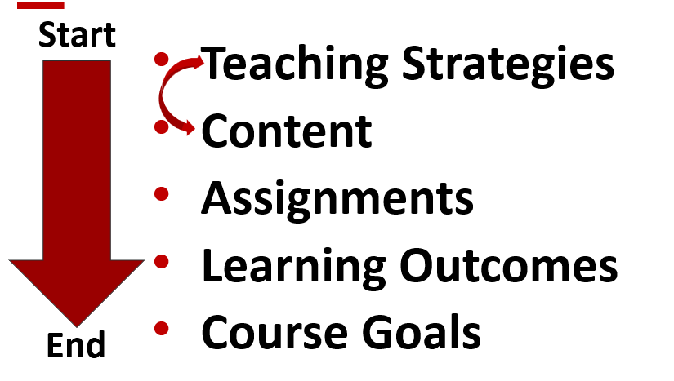
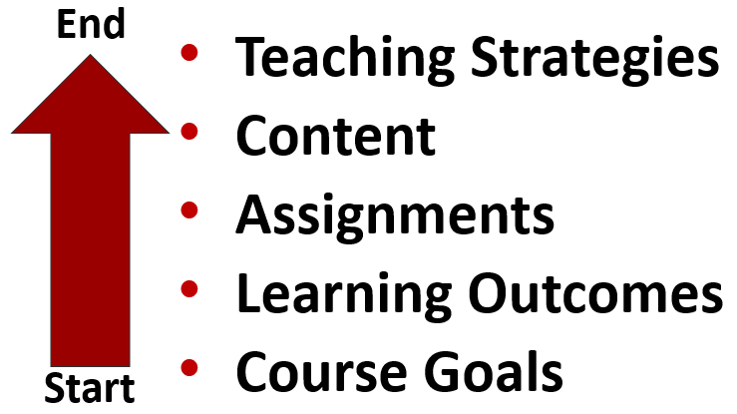
Pros & Cons of Teaching Approaches
Brainstorm with a partner the pros and cons of each approach
Content Design
Backwards Design
Notes:
Can tailor this activity based on experience of the workshop attendees. ; use giant sticky notes

Slide 9
Why Use Backwards Design?
Establishes a cohesive framework for making design choices
Guides student focus and time
Clear course goals promote:
Engagement
Metacognition
Skill mastery
Achievement
Notes:
Can go into more or less detail with this slide depending on how the previous activity shakes out. ; add more explanation to WHY these results matter ; maybe add some slide animations (especially if folks have been engaged in backward design before)

Slide 10
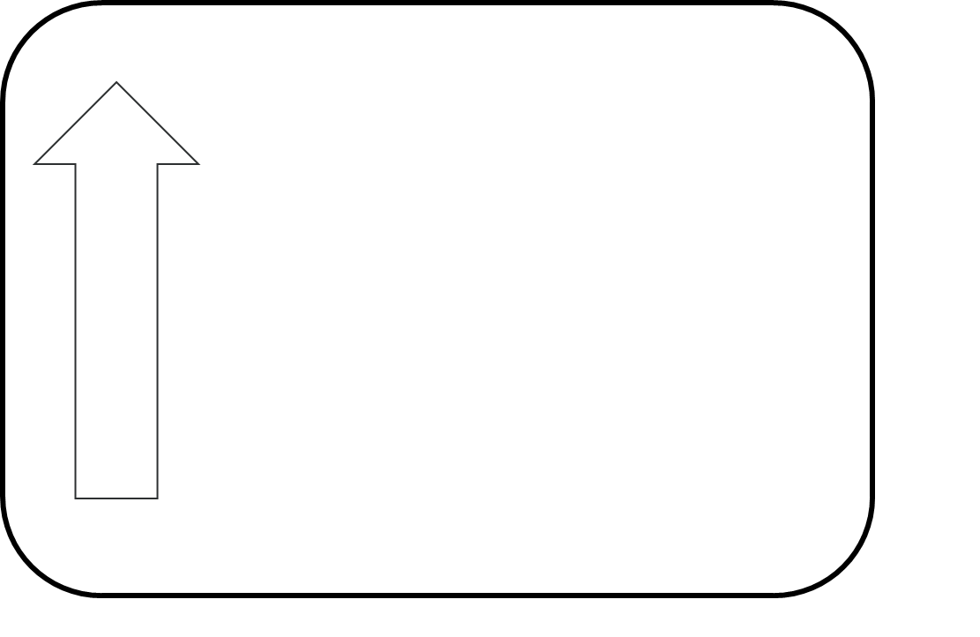
Crafting Course Goals & Transitioning Goals to Outcomes
Notes:
Discuss why a combined approach

Slide 11
Beginning at the End
Take a moment to write a short statement regarding the key takeaways you would like for students to experience after your course. These can be specific goals or outcomes or be kept more general for now.
What do you want folks to take away at the end of the course?

Slide 12
^{Course Goals? Course Outcomes?}
Course Goals | Course Outcomes
More Fuzzy Big Ideas, Changes, or Takeaways More General Utilize Stative Verbs (Ex. 'Understand') Other ideas? | Measurable and Observable (Assessable) Concrete Outcomes More Specific Utilize Action Verbs (Ex. 'Identify') Other ideas?

Slide 13
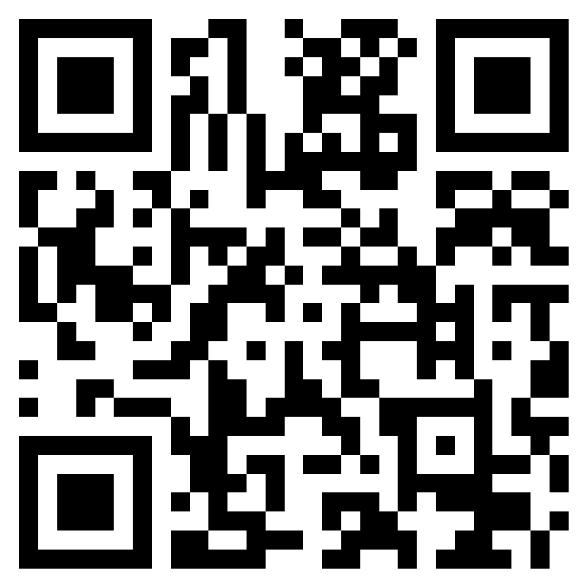
^{Quiz: Goals or Outcomes?}
For each statement, select whether it best represents a Course Goal or a Course Outcome.
Scan or visit https://forms.office.com/r/gSr4ma4XpA

Slide 14
What frameworks can help me develop these?

Slide 15

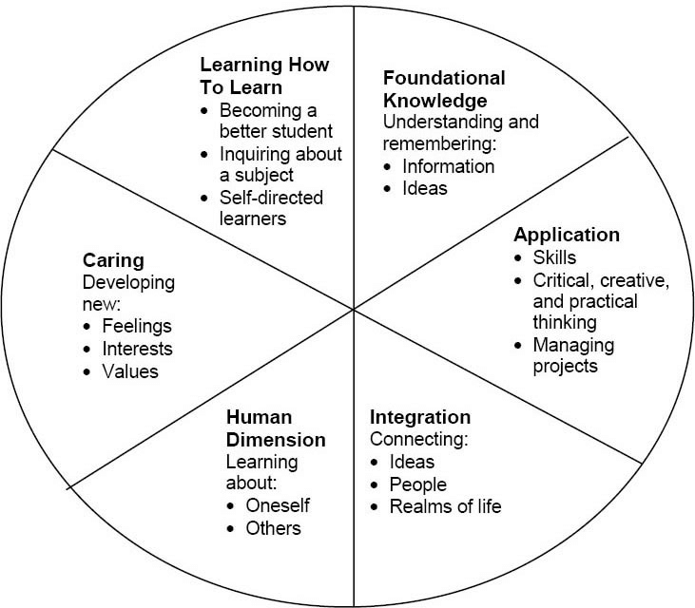
Fink’s Taxonomy of Significant Learning¹
¹Fink, 2013
Notes:
Another way of thinking...spend some time (?TBD) setting this up for folks who may not be as familiar (CT has advantage because was not familiar with this taxonomy previously + had to figure it out)
Could ask folks to revisit example/dream course and map it onto Fink's Taxonomy, or could do a think-pair-share. Or we could get an example from everyone. –Erin
Try to have assignments that tap into one or two of these dimensions
Walk everyone through the wedges ; probs the goal / outcome that they wrote down is those two wedges ; explain the WHY of it all ; spend a little bit of time in discussion / use examples from the group as well ; the challenge is to do something other than knowledge / application (can you address other wedges and how?)

Slide 16
Translating Fink’s Taxonomy to Course Goals¹
Students will:
Learning how to learn
Learn to read, Learn to study, Learn to investigate …
Caring
Appreciate, Value …
Human dimension
Reflect, Relate, Empathize, Communicate …
Integration
Connect, Integrate, Envision, Develop a Worldview …
Application
Apply, Evaluate, Plan, Create, Critique, Analyze …
Foundational knowledge
Know, Understand …
¹Fink, 2013

Slide 17
Activity: Mapping to Fink & Articulating a Course Goal
Step 1 – Analytical Reflection (Pair, 5 minutes)
Identify a course you found particularly memorable. With a partner:
Map the course to Fink’s Six Categories of Significant Learning
Discuss:
Which categories were most evident?
Which categories were missing?
Step 2 – Intentional Design (Individual, 5 minutes)
Write down 1-2 broad course goals for your proposed (Dream) course on a blue sticky note.
Post your goal(s) under the corresponding Fink’s taxonomy.

Slide 18
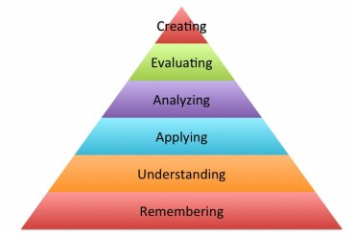
Bloom’s Taxonomy
Bloom’s Taxonomy¹
Framework for examining different levels of cognitive processing (i.e., learning)
Each level represents a concrete skills students may display
Higher level skills often reflect more complex and student-centered learning objectives
¹Anderson & Krathwohl, 2001

Slide 19
Action Verbs: Bloom’s Taxonomy¹
Remember | Understand | Apply | Analyze | Evaluate | Create
Define | Classify | Demonstrate | Contrast | Arrange | Assemble
Duplicate | Describe | Employ | Criticize | Assemble | Construct
List | Explain | Illustrate | Debate | Collect | Create
Memorize | Express | Interpret | Distinguish | Conclude | Design
Recall | Identify | Operate | Examine | Determine | Develop
Repeat | Recognize | Sketch | Question | Diagnose | Formulate
Reproduce | Report | Solve | Test | Differentiate | Write
¹Anderson & Krathwohl, 2001

Slide 20
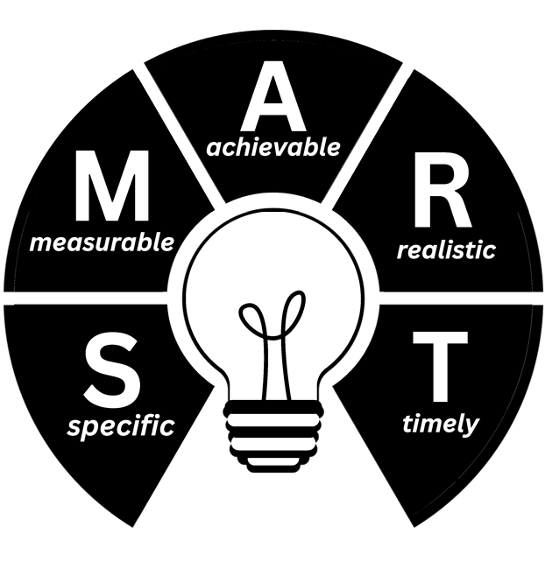
Crafting Learning Outcomes with Bloom's Taxonomy
Define progress towards goals
Bridge goals and assignments
Measurable action verbs
Learning-centered
General structure:
Students will be able to…

Slide 21
Activity: Draft and Refine Your Learning Outcomes
Individual Drafting (3-5 mins)
Select one of your Fink-based course goals.
Write 2–3 learning outcomes on yellow sticky notes using Bloom’s action verbs.
Place your learning objectives directly below your course goal to indicate alignment.
Learning objectives should:
Use Bloom’s action verbs
Describe observable student performance
Be measurable and assessable
Reflect an appropriate cognitive level
Post your learning objectives near your course goal.

Slide 22
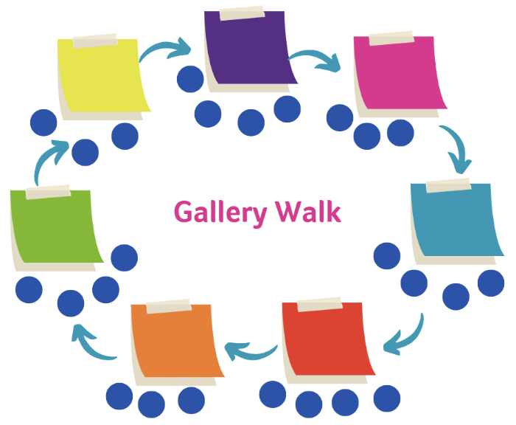
Gallery Walk
Step 1. Explore the Posters
You have 10 minutes to move freely among the six Fink’s category posters.
Step 2. Reflect on Your Colleagues’ Work
Distribution Across Fink’s taxonomy:
Which categories are most or least represented?
What patterns or trends do you notice?
Alignment:
Do the learning objectives clearly support the course goal?
Are objectives observable and measurable?
Is the chosen Bloom’s level appropriate?
Step 3. Provide Feedback
Optional: write comments or questions on a sticky note and place them beneath the relevant poster.

Slide 23
Step 3: Aligning Assignments and Outcomes
Notes:
Shana 23-33

Slide 24

Why Align Assignments and Outcomes?
Aligning outcomes and assignments helps students reach goals
Alignment helps with:
Student learning as testing/retrieval facilitates retention
Scaffolding opportunities for students to practice core skills
Ensure each learning outcome is assessed within the course
Assignment
Outcomes

Slide 25
Assignment Brainstorm & Partner Discussion
Step 1 – Individual Brainstorm
(2–3 mins)
Choose one learning outcome.
Generate as many aligned assignment ideas as possible on your worksheet.
Consider:
Small, low-stakes tasks
Large, high-stakes assessments
Scaffolded class activities
Take-home tasks
Authentic tasks
Step 2 – Partner Discussion
(5 mins)​
Share your assignment ideas with a partner.​
Discuss pros and cons of each idea.​
Decide which assignment best fits your dream course.

Slide 26
Steps 4 & 5: Selecting Content & Strategies

Slide 27
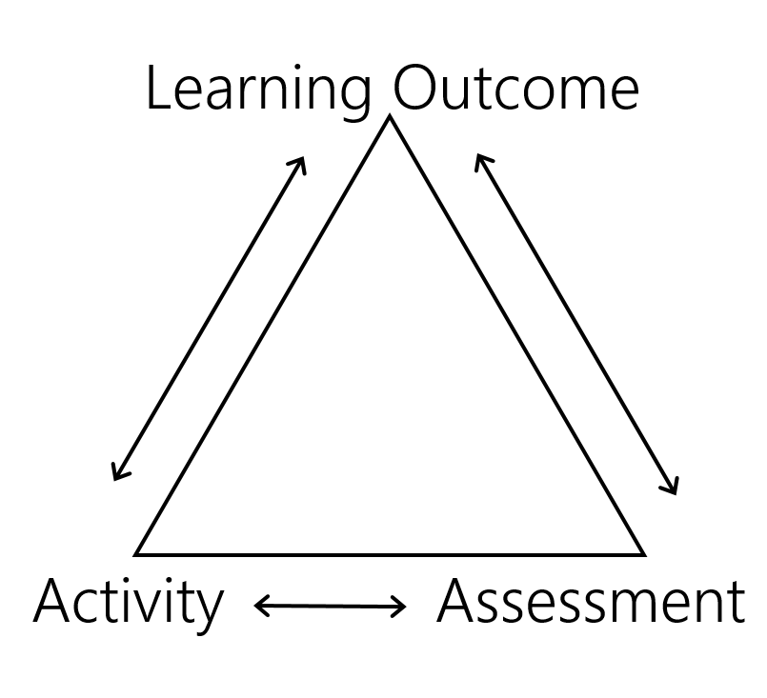
Why Assignments First?
Goals and field provide initial insights into big picture
Deciding specific content and strategies after assignments helps:
Identify the skills students need to succeed
Determine what topics are most important
Focuses the course scope to create a more meaningful experience

Slide 28
Organizing Course Content
Key Questions
Methods of Organization
Given order of assignments, when do students need this content?
How does your discipline usually organize course content and why?
How can you organize content in a student-centered approach?
Macro to micro (or v.v.)
Abstract to concrete (or v.v.)
Big Question(s)
Thematically
Chronologically
Bloom’s taxonomy – revisit content at deeper levels
Please take a few moments to think about how you would organize your dream course, then write your ideas on the worksheet.

Slide 29

Range of Instructional Strategies
Level | Teaching Strategies
Teacher-Driven | • Lecture/Direct instruction • Demonstrations • Guided practice with modeling • Structured Q&A sessions
Transitional | • Think-pair-share • Jigsaw activities • Case studies with guided questions
Student-Driven | • Student-led discussions • Independent research projects • Peer teaching • Community-based learning
Please identify strategies you will use to align your content with the assignment and your teaching goals, and note them on the worksheet.
Notes:
Increasing degrees of agency (from less to more ish); students are able to create more on their own over the range of instructional strategies ; can discuss too about how YMMV might be on the discipline, acknowledge the messiness , the endpoints and everyone else lives in the middle

Slide 30
Next Steps & Wrap Up

Slide 31


Next Steps: Revisiting and Revising
Review your course goals to ensure they focus on desired student learning
Check that learning objectives clearly align with those goals
Examine assignments to confirm they assess the intended outcomes
Revise goals, objectives, or assignments as needed for better alignment and clarity
Notes:
Note: vary time of activity as needed.

Slide 32
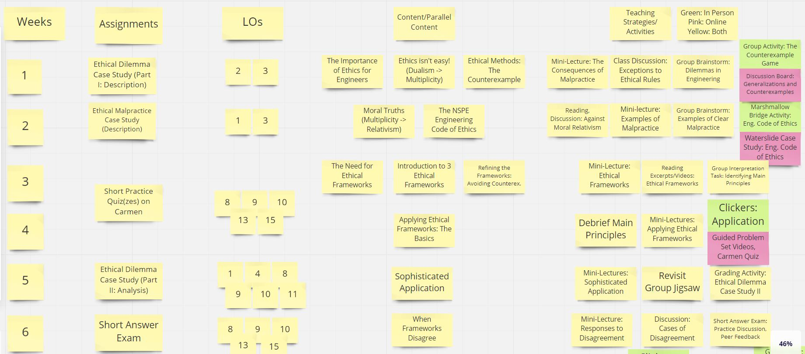
Putting the Plan Together

Slide 33




Resources
The Drake Institute for Teaching and Learning
Drake Institute Website: https://drakeinstitute.osu.edu
Drake Institute Email: drakeinstitute@osu.edu
Creating significant learning experiences: An integrated approach to designing college courses
By L. Dee Fink
Published: 2013 by Jossey-Bass
Understanding by Design (2nd ed.)
By Jay McTighe and Grant Wiggins
Published: 2005 by ASCD
See Toolkit Webpage for More Materials!
Drake Institute Graduate Toolkit Website: https://drakeinstitute.osu.edu/toolkit

Slide 34
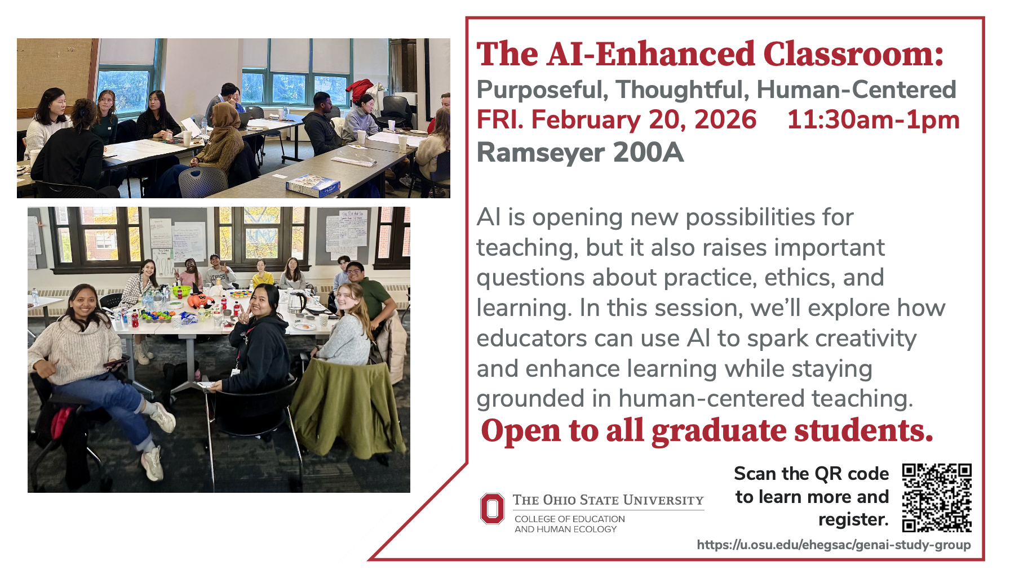
AI-Enhanced Classroom Workshop

Slide 35
Thank You! Questions?
Beginning Steps of Course Design
Erin Mercurio: mercurio.40@osu.edu
Taylor June: june.18@osu.edu
Ruonan Yang: yang.7500@osu.edu

Slide 36
References
Anderson, L. W., & Krathwohl, D. R. (2001). A Taxonomy for Learning, Teaching and Assessing: A Revision of Bloom’s Taxonomy of Educational Objectives: Complete Edition. New York: Longman.
Fink, L.D. (2013). Creating significant learning experiences: An integrated approach to designing college courses. John Wiley & Sons.
Krajcik, J., McNeill, K. L., & Reiser, B. J. (2008). Learning-goals-driven design model: Developing curriculum materials that align with national standards and incorporate project-based pedagogy. Science Education, 92(1), 1–32. https://doi.org/10.1002/sce.20240
Panadero, E., & Jonsson, A. (2013). The use of scoring rubrics for formative assessment purposes revisited: A review. Educational Research Review, 9, 129–144. https://doi.org/10.1016/j.edurev.2013.01.002
Wiggins, G., & McTighe, J. (2005). Understanding by Design (2nd ed.). Association for Supervision and Curriculum Development.
Winkelmes, M.-A., Boye, A., & Tapp, S. (2019). Transparent Design in Higher Education Teaching and Leadership: A Guide to Implementing the Transparency Framework Institution-Wide to Improve Learning and Retention. In Stylus Publishing LLC. Stylus Publishing, LLC.

Slide 37
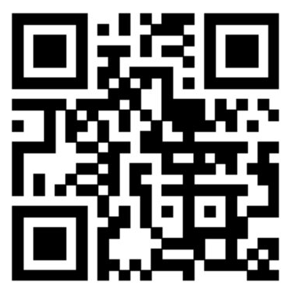
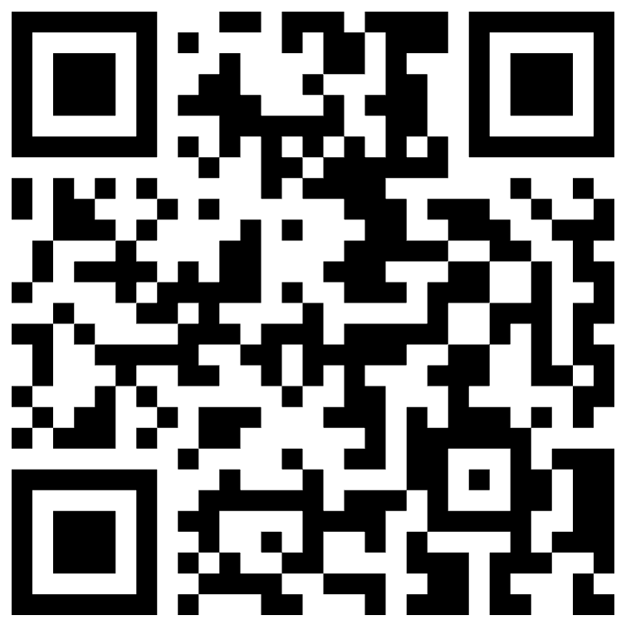
QR Code
Scan the QR below to share workshop feedback!
Scan the QR below to access Toolkit materials

