Slide 1
Accessible Course Content with Universal Design for Learning
The Michael V. Drake Institute for Teaching and Learning
Taylor June, June.18@osu.edu
Ruonan Yang, Yang.7500@osu.edu
Please sign in and grab a handout!

Slide 2

Community Norms
Listen to understand, not to respond. ​
Allow individuals the time they need to express their ideas fully. ​
Assume positive intent. ​
Own your impact on others. ​
Criticize ideas, not people. ​
Step up, step back (be aware of who has spoken and who has not.) ​
Utilize the oops and ouch system. ​

Slide 3
Outcomes
Understand the second principle of the Universal Design for Learning framework: Representation
Articulate potential barriers to accessing and understanding course information in their specific teaching context.
Identify techniques for supporting how students perceive information, understand language and symbols, and build knowledge.
Following this workshop, participants should be able to:

Slide 4
Universal Design for Learning
What is UDL?
Notes:
INTRO / WHAT IS UDL (~20 min)
Quick Recall 3 | Universal Design 2 | UD to UDL 2 | Framework 1 | Three networks 2 | Social model 2 | Quiz + access 3 | Is / isn't 2 | What's new in 3.0 2 | Today's focus 1
Mixed group: FOUNDATIONS slides bring newcomers up to speed (returners get coaching roles); GOING DEEPER slides are new for everyone.

Slide 5

Icebreaker: Quick Recall
1 Introduce yourself to a partner
Name, pronouns, department, and teaching role
2 Quick recall together
Here for Session 1? You’re the experts! Explain UDL to your partner in 60 seconds. Bonus: share one thing you’ve tried since Session 1.
New today? What might “universal design for learning” look like in a classroom?
Notes:
[~4 min: 2 min talking] This slide combines the Icebreaker and Quick Recall. Pair Session 1 returners with newcomers where possible.
Step 1: partners introduce themselves (name, pronouns, department, teaching role).
Step 2: returners explain UDL in 60 seconds and share one thing they have tried since Session 1; newcomers guess what UDL might look like from the name.
Give 2 minutes total (the embedded timer is 1 minute: play it twice or use a 2-minute timer). Then take 1-2 responses, ideally one "thing I tried" from a returner.
Say: "What you just did is one of today's strategies: activating prior knowledge. We'll come back to that in Building Knowledge."
Signpost: slides tagged FOUNDATIONS bring everyone up to speed; slides tagged GOING DEEPER are new for everyone, including Session 1 folks.

Slide 6
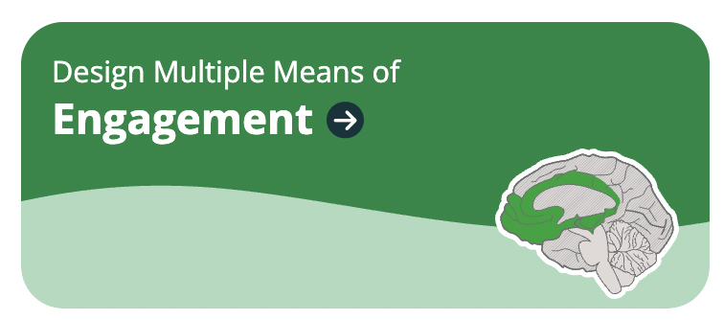
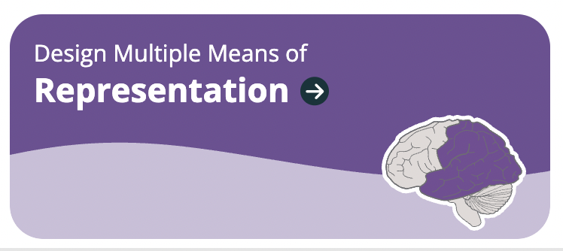
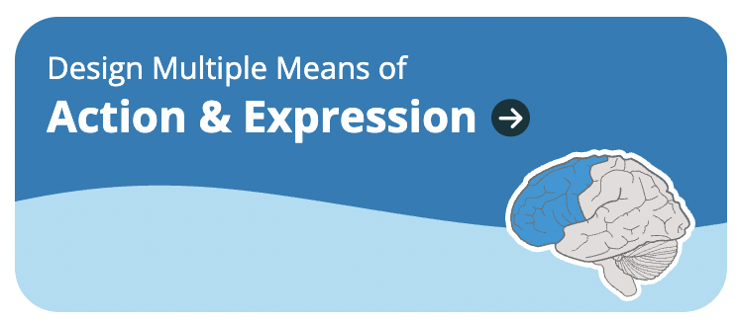
Universal Design for
Learning
A framework developed by CAST, grounded in learning science, to design learning environments that are accessible, inclusive, and challenging for every learner
Three principles:
Engagement: the why of learning (Session 1)
Representation: the what (today!)
Action & Expression: the how (Nov. 17)
Guidelines are a menu, not a checklist
Notes:
[~2 min] UDL is a framework developed by CAST, a nonprofit education research organization, and grounded in research on how people learn.
Three principles, each tied to a different aspect of learning:
- Engagement, the WHY: interest, motivation, persistence. This was Session 1.
- Representation, the WHAT: how information is presented and understood. That's today.
- Action & Expression, the HOW: how students navigate learning and show what they know. That's our November 17 session.
Each principle breaks down into guidelines and considerations (the colored graphic). They're a menu of options to choose from based on your context and goals, not a checklist to complete. Small changes count.
Structure: principles (3) contain guidelines (9), and guidelines contain considerations, the specific strategies. Today: 1 principle, 3 guidelines.

Slide 7
What UDL Is (and Isn’t)
GOING DEEPER
UDL is…
UDL is not…
✓
Proactive design for the full range of learners
✕
Only for students with documented disabilities
✓
Firm goals, flexible means
✕
Lowering rigor or expectations
✓
Something you can start small and build over time
✕
Offering endless options for everything
✓
Good for everyone, not only students with disabilities
✕
A replacement for required accommodations
Notes:
[~2 min] Common misconceptions, especially for folks new to UDL:
- It's not only for students with disabilities. Like curb cuts, it helps everyone.
- It's not lowering rigor. Goals stay firm; the paths are flexible.
- It's not offering unlimited choice on everything. Too many options can overwhelm; choose purposeful options tied to the goal.
- It doesn't replace accommodations. It reduces barriers so fewer students need to seek them individually.
- Start small: one change to one lesson is UDL. Pick one thing from today to try.

Slide 8
Today's Focus: Multiple Means of Representation
Learners differ in the ways they perceive and make meaning of information. There is no one means of representation that will be optimal for every learner, so providing options for representation is essential.
1
2
3
Perception
Interact with flexible content that offers multiple modalities and perspectives.
Language & Symbols
Communicate through languages that create a shared understanding.
Building Knowledge
Construct meaning and generate new understandings.
Notes:
[~2 min] Representation = the "what" of learning: how we present information and content.
Read the CAST framing: learners differ in how they perceive and make meaning of information. Think of learners with sensory disabilities, learning disabilities like dyslexia, and learners from diverse or non-dominant cultures and languages.
CAST also emphasizes how people, cultures, identities, and ways of knowing are represented WITHIN the content, not just the format.
Three guidelines, and we'll take them one at a time:
1. Perception (Ruonan): can learners perceive the information?
2. Language & Symbols: do the words, symbols, and notation create shared understanding?
3. Building Knowledge (me): can learners turn information into understanding they can use?

Slide 9
Sub-Principles
The 'What' of Learning

Slide 10
Perception
Design options for....
Notes:
Utilize 7 core skills as main content in this sub-principles.

Slide 11

Overview of Perception
Overview:
Learners differ in the ways they perceive and make meaning of information.
Learning is challenging, if not impossible when information is presented in inaccessible ways.
Information that reinforces stereotypes or deficit thinking can negatively affect students' experiences and learning.

Slide 12
Guidelines of Perception (1 of 3)
In print materials, the display of information is fixed and permanent. Digital materials allow the display of the same information to be flexible and customizable.
Guideline 1: Supporting opportunities to customize the display of information: Adjustability
  Sound volume
  Size of the text / images
  Color used for information
  Contrast between background and images
  Speed for the video
  Layout of visual or other elements

Slide 13
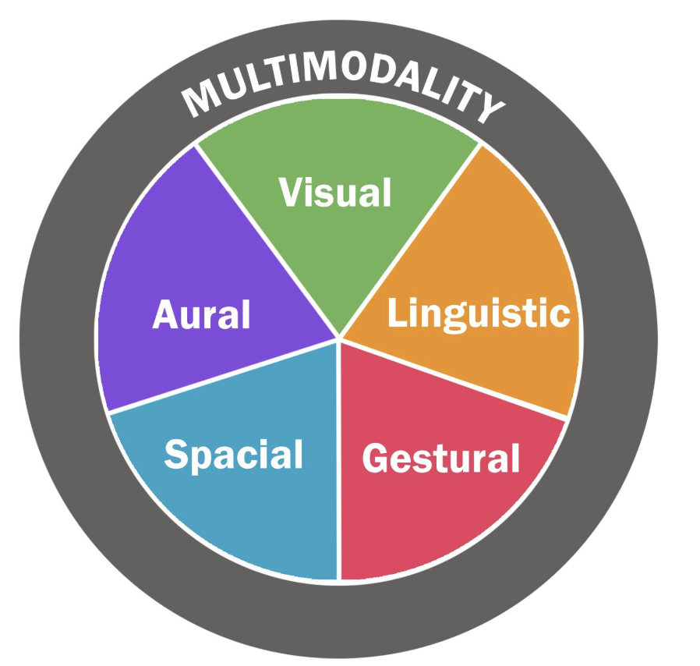
Guidelines of Perception (2 of 3)
Guideline 2: Supporting multiple ways to perceive information: Multi-modality
Offering the same information in multiple modalities can help reduce barriers to learning:
  Vision: offering text transcripts for video lectures, podcasts, and other forms of content
  Hearing: selecting textbooks and articles that have accompanying audiobooks and audio options
  Touch: illustrating concepts or assignments through physical objects

Slide 14
Overview of Accessibility
What is accessibility?
  The practice of designing products, digital content, environments, or services to be fully usable by everyone from the very beginning
Why is important to address digital accessibility?
  The Department of Justice (DOJ) published new regulations addressing digital accessibility under Title II of the Americans with Disabilities Act (ADA). The revised rule mandates that all web content and mobile apps (digital content) must be:
    Readily accessible to and useable by people with disabilities upfront.
    Fully conformant with the Web Content Accessibility Guidelines 2.1, Levels A and AA (WCAG 2.1) by April 26, 2027.

Slide 15
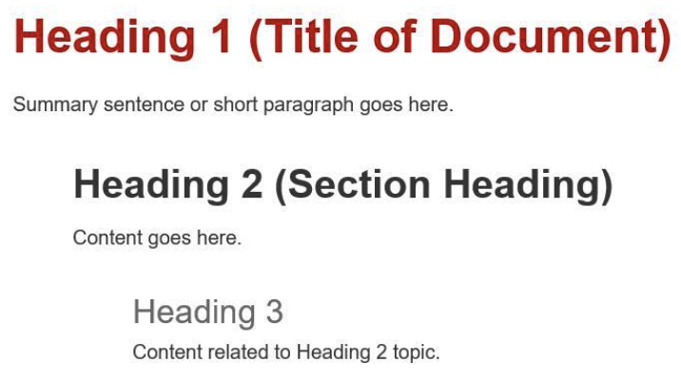
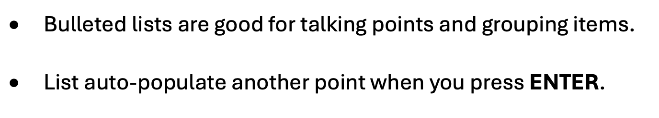
Seven Core Skills (Headings & Lists)
(Adjustability)
Headings
Use built-in heading styles: Heading 1 , 2, 3 to organize your content. In addition, make sure the headings describe the content below.
(Adjustability)
2. Lists​
Use the built-in bullets and numbering options to create lists. Avoid typing dashes or numbers to indicate a list. ​

Slide 16
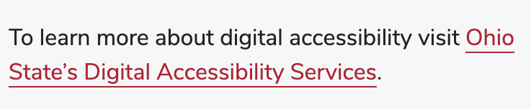
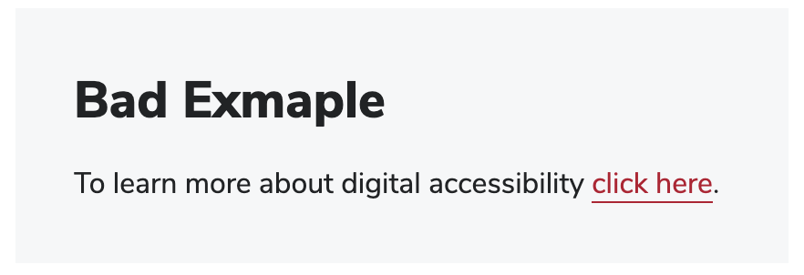
Seven Core Skills (Links)
3. Links
When using a link, provide descriptive link text instead of “Click here.” Don’t display the full URL unless the document is primarily intended to be printed. In that situation, use a URL shortener such as go.osu.edu.
(Adjustability)
❌
✅

Slide 17
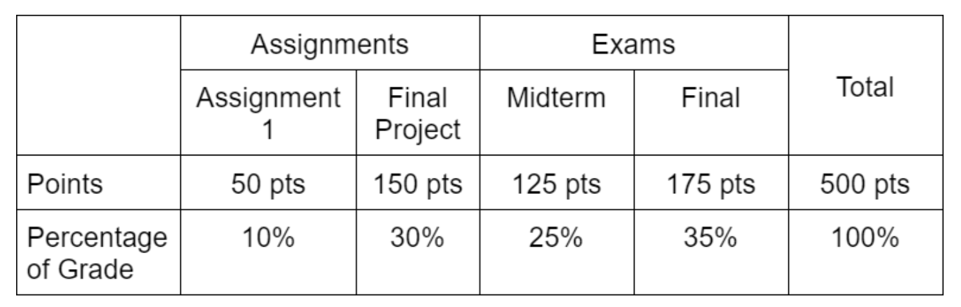
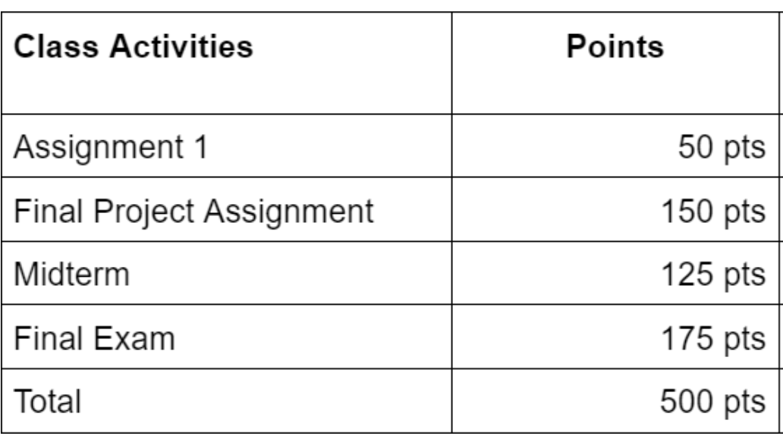
Seven Core Skills (Tables)
❌
(Both)
4. Tables
Use simple tables to organize data, rather than a complex one.
Use table formatting tools to create the table and designate column and/or row headers.
Use a descriptive caption or alt text to provide a description of the table.
Table. Final Grades Proportion
✅

Slide 18
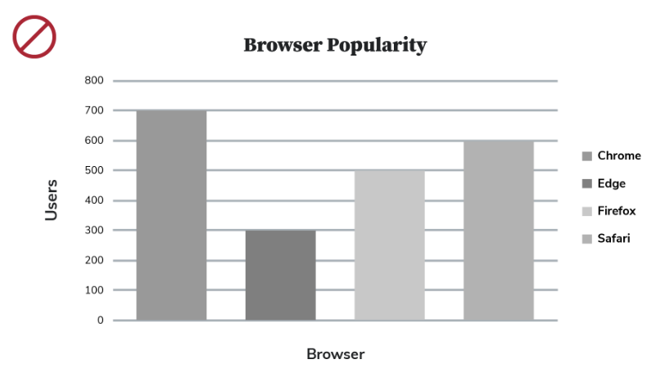
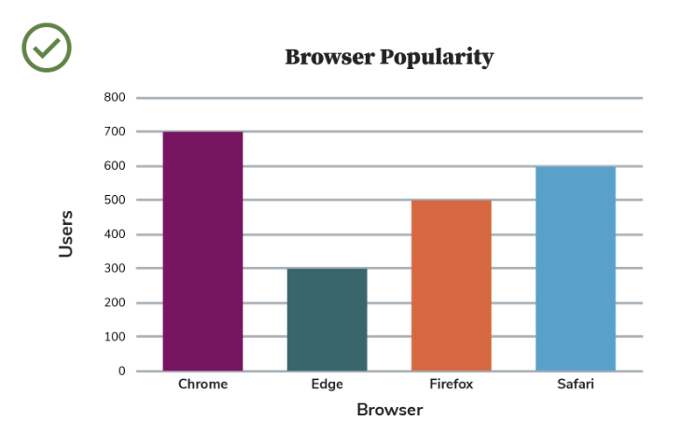
Seven Core Skills (Color and Contrast)
5. Colors and Contrast
Don’t use color as the only way to differentiate information. Ensure adequate contrast between foreground and background colors, especially for text.
(Adjustability)

Slide 19
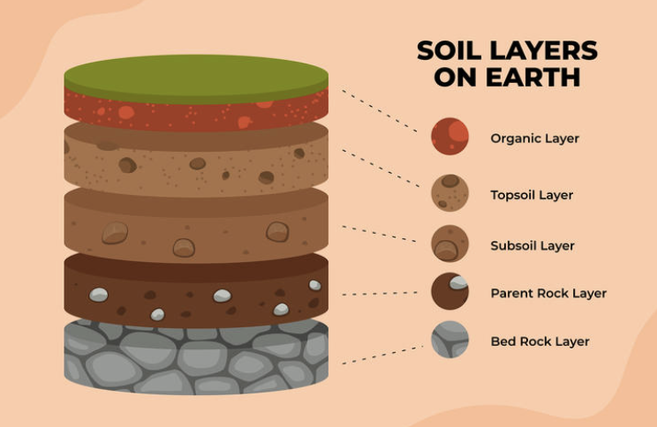
Seven Core Skills (Images and Alt Text)
(Multimodality)
6. Images and Alt Texts
All meaningful images must have a text-based alternative.
Describe the image briefly (less than 180 characters) for someone who cannot see or has a low vision.
Alt Text: Diagram of Soil Layers on Earth, from top going down: organic layer, topsoil layer, subsoil layer, parent rock layer, and last bedrock layer.

Slide 20
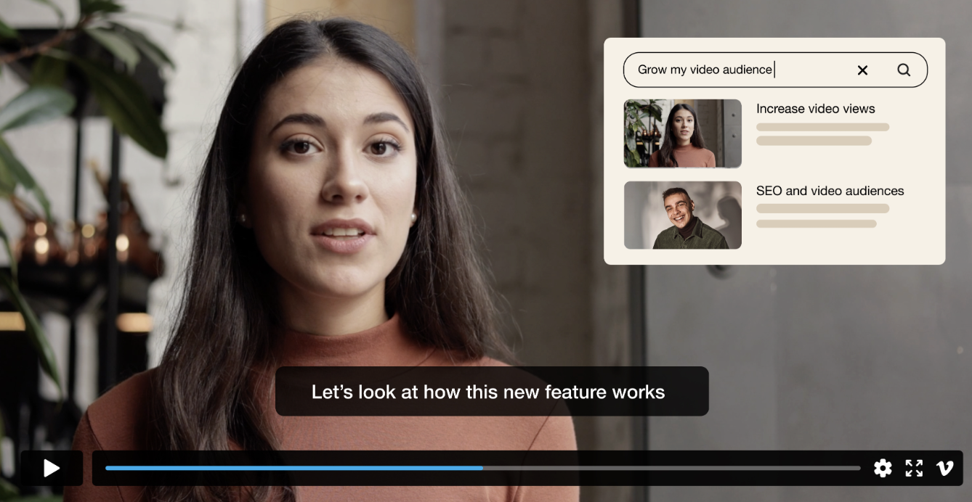
Seven Core Skills (Video and Audio)
7. Video and Audio
Ensure all videos include captions and an accompanying audio description track or text transcript.
Provide transcripts for audio-only recordings.
(Multimodality)

Slide 21
Categorization of Seven Core Skills
Supporting opportunities to customize the display of information: Adjustability
Supporting multiple ways to perceive information: Multi-modality
Headings
Lists
Links
Color and contrast
Tables
Tables
Image and alt texts
Video and audio

Slide 22
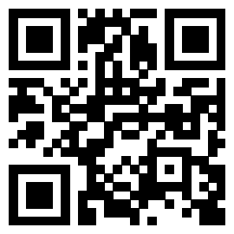

Activity: Spot the Digital Accessibility Errors
In this activity, please work as a group to examine PowerPoint slides that have accessibility issues.
Consider the following as you read through the digital document:
Is the content difficult to read or interpret?
Does the amount of information overwhelm or not provide enough information?
What specific things might you suggest to improve these documents?
Notes:
Adapt this activity to spotting accessibility issues based on 7 core skills.

Slide 23
High Accusability vs. Low Accusability
Slide 1
High accusability refers to a circumstance where the following conditions are met:
(a) deviance is known to have occurred to the point that there is reason to fear that social support for the norm will unravel
(b) it is widely believed that there are additional deviants whose identities are unknown, and
(c) credible accusations of closeted deviance are likely.
Where a+b+c = a situation of high accusability, the sincere motive inference competes with the ulterior motive inference in the minds of an audience
Two key features of high-accusability situations as contrasted with low-accusability situations:
  Enforcement is an attractive strategy for actors
  Audiences can face an inferential contest (because a closeted deviant might be dissimulating to avoid credible accusations)
Entrepreneurial Enforcement vs. Enforcement in Response to a Mandate
Click https://corpgov.law.harvard.edu/2024/05/22/the-sec-as-an-entrepreneurial-enforcer/ too check more information.

Slide 24

Scientific peer review
Slide 2
Scientific peer review refers to the process that precedes publication at academic journals:
Author submits article to journal
Journal editor, an expert in the field decides whether to consider article for publication
If yes, article is sent to about three reviewers
Reviewers decide to accept, R&R, or reject

Slide 25
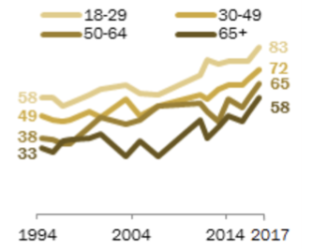
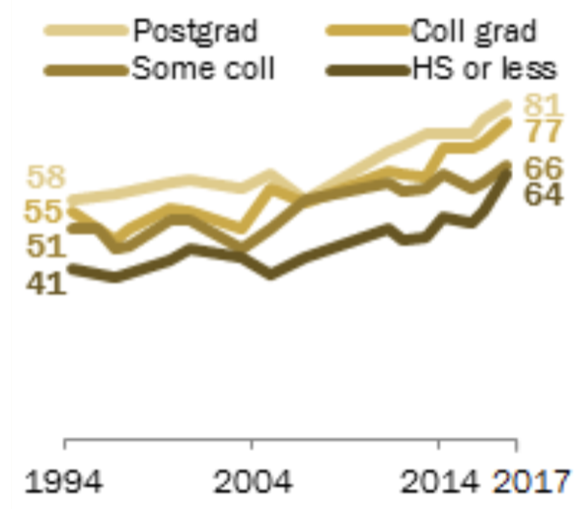
Position issues
Slide 3​
Divisive, controversial topics
What are takeaways from this graph?

Slide 26

Guidelines of Perception (3 of 3)
Guideline 3: Representing a diversity of perspectives and identities in authentic ways: Diversity in perspectives
Facilitate listening such as storytelling to embrace diverse perspectives.
Attend to the ways in which people and cultures are being portrayed.
Challenge stereotypical or harmful portrayals of people and cultures.

Slide 27
Language & Symbols
Design options for....

Slide 28

Language & Symbols
Overview:
Learners vary in their facility with different forms of representation.
Inequalities may arise when information is presented to all learners through a single form of representation.
An important instructional strategy is to ensure that multiple representations are available not only for accessibility, but for clarity, comprehensibility, and creating a shared understanding for all learners.

Slide 29


Activity: Same Same, but Different
In this activity, you will see different symbols and vocabulary on the screen. Please feel free to think about what it means to you.
Appendix
d=2r

Slide 30

Guidelines of Language & Symbols
Clarify vocabulary, symbols, and language structures
Support decoding of text, mathematical notation, and symbols
Cultivate understanding and respect across languages and dialects
Address biases in the use of language and symbols
Illustrate through multiple media

Slide 31
Clarify vocabulary, symbols, and language structures
Barrier:
Jargon, idioms, and unfamiliar terminology can create barriers to understanding.
Example:
Idioms such as “off the hook” may not be universally understood.
UDL Strategies:
Pre-teach vocabulary and symbols
Provide alternative text descriptions for graphic symbols
Break complex terms into simpler parts.
Clarify unfamiliar syntax references and sentence structures.

Slide 32
Support decoding of text, mathematical notation, and symbols
Barrier:
Decoding words, equations, and symbols can interfere with comprehension. Learners develop decoding fluency at different rates.
Examples:
A student who struggles to read the algebraic expression 3x + 5 = 20 uses text-to-speech and a key-terms list ("variable," "equation") to focus on solving the problem, not decoding the symbols.
UDL Strategies:
Allow text-to-speech.
Use digital notation with automatic voicing (e.g., MathML).
Offer multiple representations (formulas, word problems, graphs).
Provide lists of key terms to clarify notation.

Slide 33
Cultivate understanding and respect across languages and dialects
Barrier:
Course materials are often designed for a single language, but learners bring diverse linguistic backgrounds.
Examples:
An ESL student gets a science word list with English and their first language definitions and pictures.
UDL Strategies:
Provide key information and vocabulary in multiple languages.
Use simple words to define domain-specific terms.
Add visual supports (pictures, videos) and translation tools or multilingual glossaries.
Support translanguaging so learners can use their full linguistic range.
How will you explain "photosynthesis" in simple words or any other languages?

Slide 34
Address biases in the use of language and symbols
Barrier:
Prioritizing academic English can marginalize other languages and dialects.
Examples:
A teacher labels classroom items in English and students' home languages, and welcomes students to speak or write in their home language or dialect.
UDL Strategies:
Welcome multiple languages and dialects.
Use closed captions (in more than one language) and sign language.
Label classroom items in multiple languages.
Teach standard English without devaluing home languages.

Slide 35
Illustrate through multiple media
Barrier:
Text alone may limit access to content for some learners.
Examples:
A lesson on the water cycle includes text, a diagram, an animation, and a physical model.
What to do:
Present key concepts in multiple formats (illustration, diagram, video, model, movement, comic strip).
Pair text with visuals or interactive media.

Slide 36

Activity: Explain Terms in
Multiple Ways
In this activity, please work as a group to design multiple ways to explain one term so every learner can understand it. Feel free to jot down some keywords on the worksheet.
Step 1: Choose a key term and your learners (grade level and language proficiency)
Step 2: Design 2-3 ways to explain the term, demonstrating the guidelines under "Language and Symbols"
Step 3: One person from each group shares your groups discussion about the term, learners, and representations

Slide 37
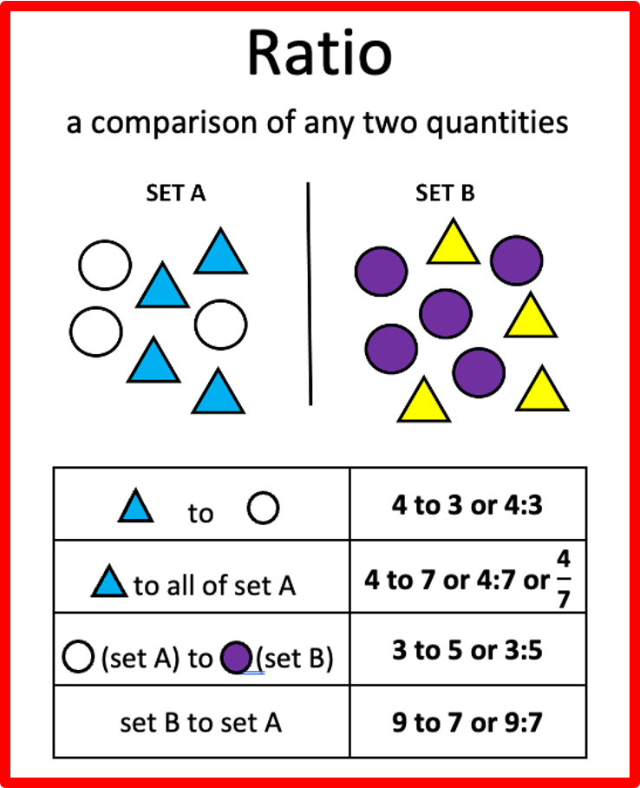
Activity Example
Learning goal: Students will be able to understand the Math term "ratio"
Learner' Background: Fifth-grade ESL (English as a Second Language) students
Instruction support:
  Pre-teach math vocabulary (e.g., Math vocabulary word wall cards)
  Pair words with visuals
  Provide sentence frames (e.g., “First, I sort… because… Second, I color… because… ”)

Slide 38
Term Bank
Please choose one of the terms below or select another term that your group is interested in exploring.
Probability
Average
Variables
Photosynthesis
Evolution
Latitude
Longitude
Gravity
Friction
Reaction force

Slide 39
Building Knowledge
Design options for....
Notes:
BUILDING KNOWLEDGE (~22 min). One anchor lesson runs through every activity, recorded on the Building Knowledge worksheet.
Overview + guidelines: 2 min | Choose Your Anchor Lesson: 1.5 min | 3.1 + Bridge Builder (Part 1): 5 min | 3.2 + Headline It (Part 2): 3.5 min | 3.3 Ways of Knowing (Part 3): 5 min | 3.4 + Map Your Lesson (Part 4): 7 min
Headline It is no longer optional: the final concept map uses the headline. If short on time, trim the strategies slide for 3.3 or skip the Summary.

Slide 40

Building Knowledge
Overview:
Information alone isn’t knowledge: learners must actively construct meaning by connecting, organizing, and questioning
Experts see patterns and big ideas; novices often see isolated facts
We can design options and scaffolds that help every learner turn information into understanding they can use in new contexts
Notes:
[~2 min] CAST Guideline 3: "Construct meaning and generate new understandings."
Key idea: we can present information perfectly (Perception) in clear language (Language & Symbols) and students still might not build knowledge from it. Building knowledge is active.
Expert/novice point: part of our job is making the expert "invisible structure" of our discipline visible to students.
Because students arrive with different backgrounds, experiences, and ways of knowing, there's no single path to understanding, so we design options.

Slide 41
Guidelines of Building Knowledge
Goal: construct meaning and generate new understandings. CAST breaks this into four “considerations” (specific strategies):
3.1
Connect prior knowledge to new learning
Build connections to prior understandings and experiences.
3.2
Highlight and explore patterns, critical features, big ideas, and relationships
Accentuate important information and how it relates to the learning goal.
3.3
Cultivate multiple ways of knowing and making meaning
Honor multiple and diverse ways of developing understandings of the world.
3.4
Maximize transfer and generalization
Apply learning to new contexts.
Notes:
[~2 min] Vocabulary: CAST organizes UDL in three layers. Principles (Engagement, Representation, Action & Expression) contain guidelines (like Building Knowledge), and each guideline contains "considerations," which are specific, practical strategies. The numbers (3.1, 3.2...) are just CAST's labels.
Give a one-line preview of each:
3.1 Connect prior knowledge: build on what students already know and have experienced.
3.2 Highlight patterns and big ideas: make what matters most visible.
3.3 Multiple ways of knowing: honor diverse ways of understanding the world.
3.4 Transfer: help students apply learning in new contexts.

Slide 42
Activity: Choose Your Anchor Lesson
Every activity in this section builds on the same lesson, so you leave with a plan you can use.
On your worksheet, jot down:
A lesson (upcoming, past, or one you make up)
One concept in it that students often struggle with
A few words about your students (level, background)
Where your lesson goes next
1 Bridge it
Connect it to what students already know
2 Headline it
Name the big idea
3 Widen it
Invite other ways of knowing
4 Map it
Pull it together, and name where else it applies
Example - Intro to Sociology
Lesson: The sociological imagination (week 2)
Tricky concept: Seeing how personal troubles connect to public issues
Students: First-years, mixed majors; most new to social science

Slide 43
Connect Prior Knowledge to New Learning
New learning sticks when it connects to what learners already know. But students bring different prior knowledge, so we design ways in for everyone.
Meta moment
Our Quick Recall at the start of today activated your prior knowledge about UDL.
1
Activate: Open with a question, poll, or quick recall
Bridge: Use analogies, metaphors, and everyday examples
2
Pre-teach: Don’t assume shared background; define essential concepts and norms (remember the hidden curriculum!)
3
Map it: Concept maps show how new ideas attach to what students already know
4
Notes:
[~2 min] Consideration 3.1: Build connections to prior understandings and experiences.
Students come in with very different prior knowledge: from other courses, from work, from their families and communities. Some of that is an asset we can build on; some gaps are invisible to us (hidden curriculum from Language & Symbols).
Strategies: activate (question, poll, recall), bridge (analogies and everyday examples), pre-teach (define essential concepts), map it (concept maps; participants will make one for their anchor lesson at the end of this section).
Meta moment: point back to the Quick Recall at the start, then say the next activity applies the Bridge move to their anchor concept.
Reference on concept maps: https://www.morgan.edu/academic-affairs/resources/instructional-technology/teaching-with-technology/concept-maps

Slide 44
Activity: Activate and Bridge
On your own: Start with your anchor concept (worksheet Part 1).
Jot down:
What might students already know (from everyday life, other courses, or their communities) that connects to it?
How could you help students recall what they know?
A one-sentence analogy, example, question, or activity that builds a bridge to the new concept
Pair: Trade answers with a neighbor. Would it work for all your students? Whose experiences might it leave out?
Example · Intro to Sociology
Already know: Rent, tuition, job hunting, textbook prices
Bridge: One student can’t afford the book vs. half the class can’t
Notes:
[~3 min] 2-minute timer: about 1 min solo, 1 min with a partner. Take one quick share if time.
Participants work on the anchor concept they chose two slides ago and write on worksheet Part 1.
The pair question is the UDL twist: an analogy based on, say, American football or a specific cultural reference works for some students and excludes others. Offering more than one bridge gives more students a way in.
If people get stuck, example: explaining electrical resistance as traffic on a narrow road vs. a highway.

Slide 45
Highlight Patterns, Critical Features & Big Ideas
Novices can’t always tell what matters most yet. Make the important parts, and how they connect, visible.
1
Name the big idea explicitly at the start and end of class
“If you remember one thing from today, it should be…”
A simple sentence that tells students which idea everything else hangs on.
2
Use examples and non-examples to spotlight critical features
3
Show relationships with graphic organizers, outlines, and compare/contrast tables
4
Cue what matters with headings, bold text, or callouts (never color alone!)
5
Cut the clutter by removing extra detail that competes with the key point
Notes:
[~2 min] Consideration 3.2: Highlight and explore patterns, critical features, big ideas, and relationships. "Accentuate important information and how it relates to the learning goal."
Experts automatically filter signal from noise. Students often give equal weight to everything on the slide, which is why they highlight the whole page.
Connect to Perception: cueing with bold or headings is great, but never rely on color alone (7 core skills).
Examples/non-examples: e.g., show a strong thesis next to a statement that's just a topic, and ask what the difference is.

Slide 46

Activity: Headline It
Write: Write the big idea of your anchor lesson as a newspaper headline, 10 words or fewer (worksheet Part 2).
Then ask yourself: What’s one detail you could cut, move, or save for later so the headline stands out?
Share: A few volunteers read their headlines aloud.
Example · Intro to Sociology
Headline: “Your Problems Aren’t Just Yours: Society Shows Up Everywhere”
Cut: Mills’s biography and the history of the term; save it for the reading
Notes:
[~2 min] 1-minute timer, then 2-3 volunteers read headlines aloud (popcorn style, no need to explain).
Same anchor lesson as Bridge Builder; participants write on worksheet Part 2. Keep this activity: the final concept map uses the headline.
The example continues the running Intro to Sociology lesson on the sociological imagination.
Point to make: if you can't write the headline, students probably can't either, and that's a signal the big idea needs to be named more explicitly.

Slide 47
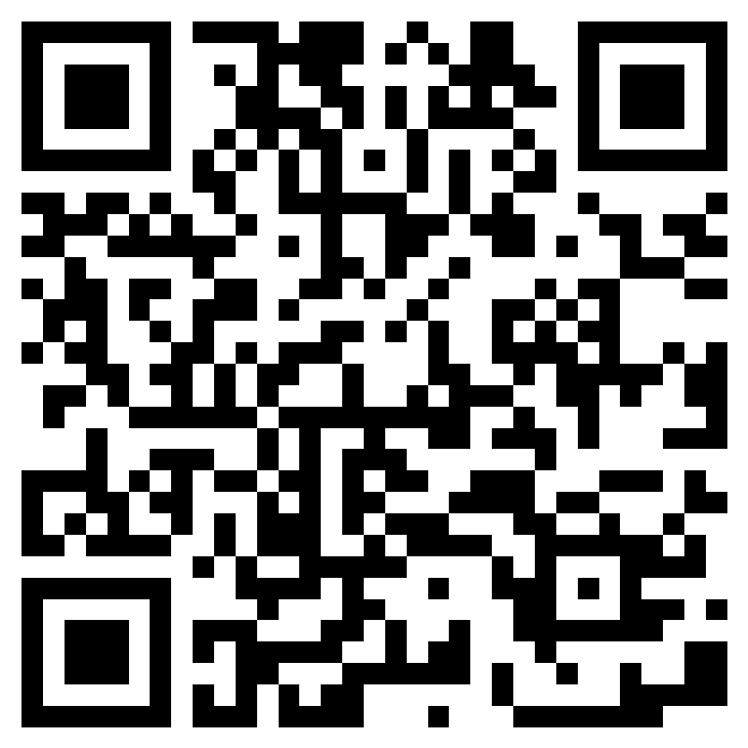

Cultivate Multiple Ways of Knowing
Honor multiple and diverse ways of developing understandings of the world.
Empirical research
Lived experience
Cultural & community traditions
Practice & craft
Story & oral tradition
Art & embodiment
Insert QR code
Try it · 5 min
Scan the QR code to open the Microsoft Form.
Pick a way of knowing above that could help students understand your anchor concept. Add 1–2 ways to bring it into that lesson (worksheet Part 3).
Example (Sociology): a family story of hard times. What shaped it?
The Michael V. Drake Institute for Teaching and Learning
47
Notes:
[~5 min] Ask participants to scan the QR code to open the Microsoft Form.
Prompt: Look at the six ways of knowing. Pick one that could help students understand your anchor concept, and add 1-2 concrete ways to bring it into that lesson (an assignment, a guest, a discussion prompt, a source, an assessment option). They also jot it on worksheet Part 3.
Give 3 minutes, then open the Form's Responses tab on screen and highlight a few ideas, grouping them by way of knowing. Then advance to the strategies slide.

Slide 48
Cultivate Multiple Ways of Knowing
Strategies to compare with your ideas.
Present knowledge from multiple traditions alongside disciplinary methods, not as an add-on
Example
In a unit on pain, pair clinical trial data with patients’ own accounts, and ask what each one reveals that the other misses.
Invite students to bring their own ways of knowing into discussion and assignments
Example
Offer a project option where students draw on a family, community, or workplace practice and connect it to course concepts.
Discuss openly whose knowledge counts in your field, and why
Example
Have students look at who is cited in a key textbook chapter, whose voices are missing, and how the field decided what counts as evidence.
The Michael V. Drake Institute for Teaching and Learning
48
Notes:
Connect these strategies back to the ideas participants shared in the Form on the previous slide. Invite participants to suggest examples from their own fields.

Slide 49
Maximize Transfer and Generalization
Learning isn’t finished until students can use it somewhere new: the next course, their job, their community.
Vary the context
Space it out
Give tools that travel
Ask “where else?”
Practice the same idea in different settings, formats, and problems
Revisit key ideas across the term; mix old and new practice
Checklists, templates, worked examples, and mnemonics
Prompt students to name new situations where the idea applies
Notes:
[~2 min] Consideration 3.4: Maximize transfer and generalization. "Apply learning to new contexts."
Transfer is the whole point of learning, and it doesn't happen automatically. Students often learn an idea tied to one context (one problem type, one example) and don't recognize it elsewhere.
Four moves: vary the context, space and revisit, give tools that travel, and explicitly ask "where else would this apply?"
Transition: let's practice transfer ourselves. You'll pull your anchor lesson together in a concept map and add where else it applies.

Slide 50

Activity: Map Your Lesson
Turn your worksheet into a concept map (Part 4). Put your anchor concept (e.g., the sociological imagination) in the center and add a branch for each strategy.
Draw lines between ideas that connect. Then tell a partner what you’ll try first.
Bridge it
Your bridge from Part 1 (e.g., textbook prices: one student vs. half the class)
Headline it
Your headline from Part 2 (e.g., “Your Problems Aren’t Just Yours: Society Shows Up Everywhere”)
1
2
Widen it
Your way of knowing from Part 3 (e.g., a family story about a hard time)
Where else? (new)
Two places students could use it next (e.g., news stories, workplace burnout)
3
4
Notes:
[~6 min] 5-minute timer, then 1-2 volunteers share.
This is the synthesis: participants turn worksheet Parts 1-3 into a concept map of their anchor lesson (worksheet Part 4). The concept goes in the center; each branch comes from an earlier activity. The only new branch is "Where else?": two places students could use the concept next (the transfer move).
It also models the "Map it" strategy from the Connect Prior Knowledge slide: a concept map shows how ideas attach to each other.
Share-out prompt: "What concept did you map, and what will you try first?"
Name the meta moment at the end: taking today's ideas into your own lesson is exactly what transfer means.

Slide 51
Summary: Building Knowledge Strategies
3.1
Connect Prior Knowledge
Open with a question, poll, or quick recall
Bridge with analogies and everyday examples
3.2
Highlight What Matters
Name the big idea at the start and end
Use examples, non-examples, and organizers
3.3
Cultivate Ways of Knowing
Integrate multiple knowledge traditions
Invite students’ own ways of making meaning
3.4
Maximize Transfer
Practice across varied contexts; revisit often
Ask: “Where else would this apply?”
Notes:
[optional, ~1 min] Reference slide; skip or point to the worksheet if short on time.

Slide 52




Resources
The Drake Institute for Teaching and Learning
Drake Institute Website: https://drakeinstitute.osu.edu
Drake Institute Email: drakeinstitute@osu.edu
Decolonizing Methodologies: Research and Indigenous Peoples
Linda Tuhiwai Smith
Zed Books, 1999
Braiding Sweetgrass
Robin Wall Kimmerer
Milkweed Editions, 2013
See Toolkit Webpage for More Materials!
Drake Institute Graduate Toolkit Website: https://drakeinstitute.osu.edu/toolkit

Slide 53
Fall 2026 Toolkit Workshop Schedule
Fall Series – Universal Design for Learning (UDL)
November 17 (Barbie Tootle, 3rd Floor, Ohio Union)
  Creating Flexible Assignments and Activities with Universal Design for Learning
Time: 11:30 am - 1:00 pm (Tue)

Slide 54
Thank You! Questions?
Accessible Course Content with Universal Design
for Learning
Erin Mercurio: mercurio.40@osu.edu
Taylor June: june.18@osu.edu
Ruonan Yang: yang.7500@osu.edu

Slide 55
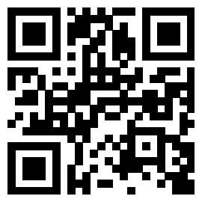
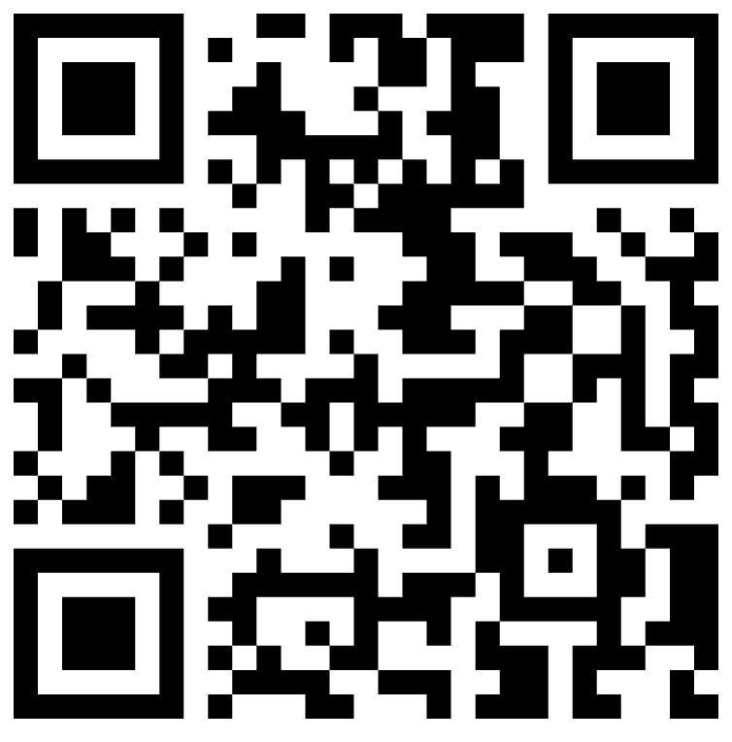
QR Code
Scan the QR below to share workshop feedback!
Scan the QR below to access Toolkit materials
go.osu.edu/toolkit-survey

